Slide 1
Title & Escrow Potpourri
Presented by:
Charlie Cookson, Commercial Underwriter
Fidelity National Title Group, Oregon CPF/Oregon CPF South
Tara Thompson, AVP/Regional Manager
Western Title & Escrow Company

Slide 2
Overview
Tiny Homes
FHA Homes involving Bare Land
Powers of Attorney

Slide 3
Tiny Homes

Slide 4
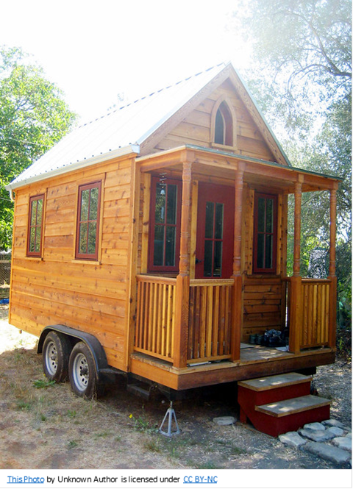
Classifications
Permanent (stick built on land)
Treat as a regular escrow transaction
Temporary (Park Model Recreational Vehicle or PMRV)
As of January 1, 2020, these can be titled only, not registered through the DMV. MHODS has not processed them for over a year.

Slide 5
Park Model Recreational Vehicle (PMRV)
Has been manufactured to the ANSI A119.5 standard and
Be over 8.5 feet wide; and
Be designed for use as temporary living quarters; and
Be built on a single chassis mounted on wheels; and
Have a gross trailer area of 400 square feet or less; and
Not be permanently affixed to land for use as a permanent dwelling, or
Be located in a mobile home park.

Slide 6
DMV Titling Requirements
NEW TINY HOME
USED TINY HOME
Completed Application for Title and Registration including the site address.
The original MCO (Certificate of Origin)
Proof that the PMRV complies with ANSI A 119.5 standard, this can be on the original MCO or a letter from the manufacturer
Fee is $98.00
Completed Application for Title and Registration including the site address. Certification on page 2 for compliance with ANSI A 119.5 standard.
The original Oregon title, out of state title, or the Oregon Manufactured Structure Ownership Document.
Bill of sale
Original lien releases on DMV FORM ONLY
Fee is $98.00

Slide 7
Can I close this transaction?

Slide 8
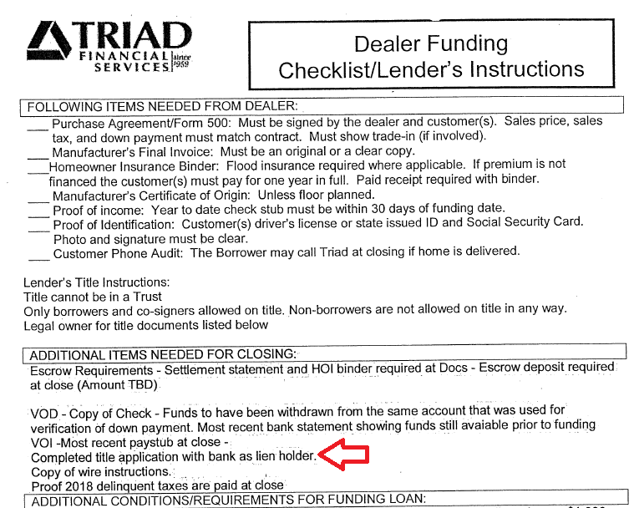
Can I follow my lender’s instructions?

Slide 9
Taxation and Assessment Requirements
Contact your local County/Taxing Authority where the PMRV will be located to obtain information on how to update the tax records as they are taxed as personal property.

Slide 10
DMV Ownership Verification Instructions
You can register to get an account with the DMV for $70.00 per year. There is a per record request fee that is assessed as well.
You need to have the VIN or Plate # to make a request.
This will give you the title holder information as well as any security interest holder. The link to the DMV record inquiry accounts is below:
https://www.oregon.gov/odot/DMV/pages/records/recinquiry_daveaccts.aspx

Slide 11
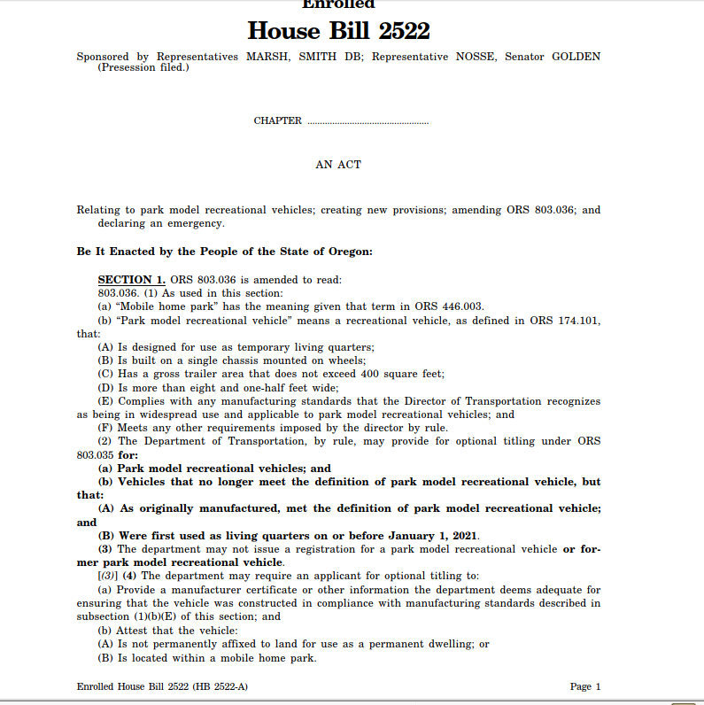

Slide 12
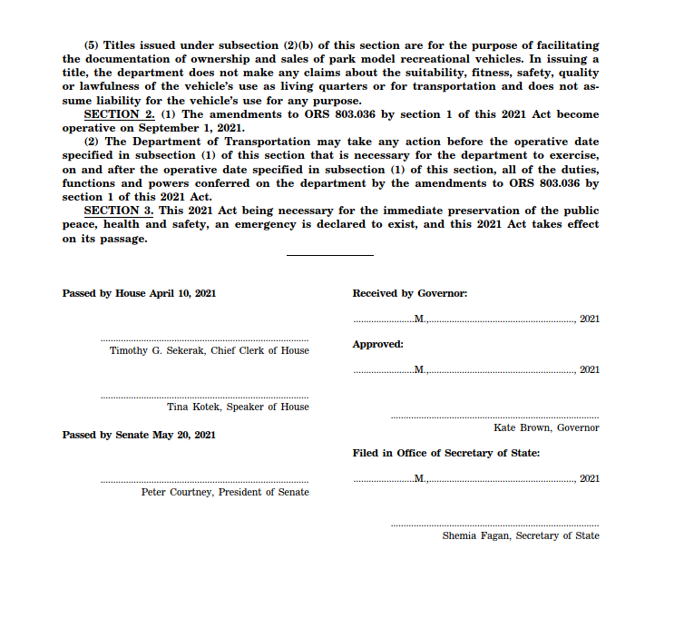

Slide 13
Manufactured Homes Update
As of March 6, 2020, MHODS has discontinued the practice that they will not transfer manufactured homes older than 1975 without proper evidence demonstrating that the home is a legal structure, designed and built to a code standard acceptable to Oregon such as a HUD number.

Slide 14
LOANS ON LAND THAT INCLUDE A BARE LOT

Slide 15
Lender requirements involving bare land. (Often FHA but includes others)
2 Tax Lots
One property
One large challenge!

Slide 16
Lender requirements involving bare land. (Often FHA but includes others)
“Hey Charlie, this is Alfie P. Lem, in Recording. We have a deed that they want us to insure. It only has #1 Dollar for a consideration. Can we insure for a Dollar? “
This is often the first clue that there is a problem in the works

Slide 17
Lender requirements involving bare land. (Often FHA but includes others)
If subject property includes two tax lots (The Residence and a bare lot Next Door), FHA will often reject the loan
The bare lot may not appear physically to be separate property.
The bare lot may be necessary for use and enjoyment of the residence. Parking Area, Driveway, Yard, Septic

Slide 18
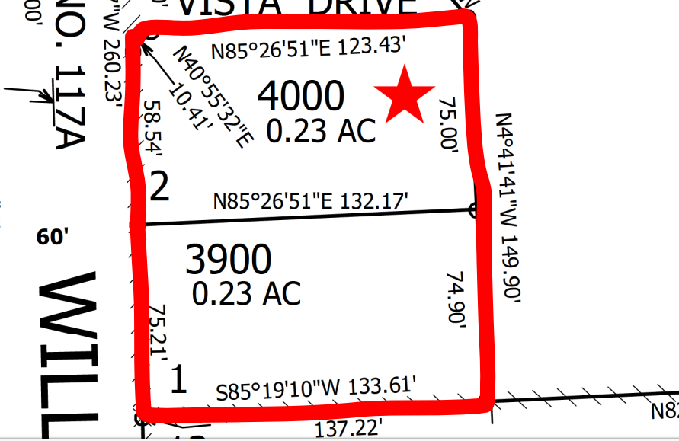

Slide 19
Examples
Sale Price of $400,000 with a Loan of $375,000. Lots 1 & 2 of Mayberry Subdivision. The Two Lots are separate tax lots.
Lender will not loan on it if Bare Lot is Included

Slide 20
Client Solution
Sign an addendum to the Sale Agreement for sale to “only” be on lot 2 using original dollar amounts.
Loan to only encumber lot 2.
Execute a New Sale Agreement on lot 1 for a dollar.
“It’s the only way we can get the Lender to loan on it!”

Slide 21
Client Solution
Deed for Lot 2 has a consideration of $400,000
Followed by the Trust Deed for $375,000
Deed for Lot 1 has a consideration of $1.00
How would the Title Insurance work in this scenario?
Can we really insure the one lot for $1.00

Slide 22
Client Solution Title Insurance Questions…..
Break into two owner’s policies - one for each lot?
Allocate owner’s title insurance amounts for each owner policy
$400,000 sale with $375,000 loan
Do you reflect 1st prelim for the house as a $350,000 owner’s policy with a $375,000 lender’s policy and the second prelim as a $50,000 owner’s policy?
Will the lender accept that?

Slide 23
Client Solution Title Insurance Questions…..
How about Issuing an Owners Policy on both lots and just issuing the Loan policy on lot 2?
This works fine for the Title Department but the Lender will probably not be ok with the second lot showing on their prelim.

Slide 24
Client Solution Title Insurance Questions…..
“If the tax assessment is high enough, can't we just write an owner’s policy on Lot 2 for $400,000 and also write an owner’s policy on Lot 1 for $50,000?
Maybe… but what is “The Value of the Estate”?
OTIRO 3.001 BASIS OF CHARGE
The charge for an owner’s policy shall be based upon the full value of the estate or interest covered by the policy without reduction for the amount of liens and encumbrances thereon. Insurance in excess of the full value of the estate or interest covered by the policy may be purchased to cover anticipated improvements, in which case the Company, in its discretion, may include a pending improvements endorsement with the policy.

Slide 25
Challenges with Client solution
Now you have issued Owner’s Title Insurance for $450,000
For a property that sold to a BFP for $400,000
Boy, I sure hope there isn’t a claim!!

Slide 26
Challenges with Client solution
If the loan only encumbers lot 2 and the lender has to foreclose…
What if there are encroachments ?
Highly likely when developed as one property.
Septic can be an easily overlooked problem.
What about power and water?
Driveways? Parking?
What if a Survey is now required?

Slide 28
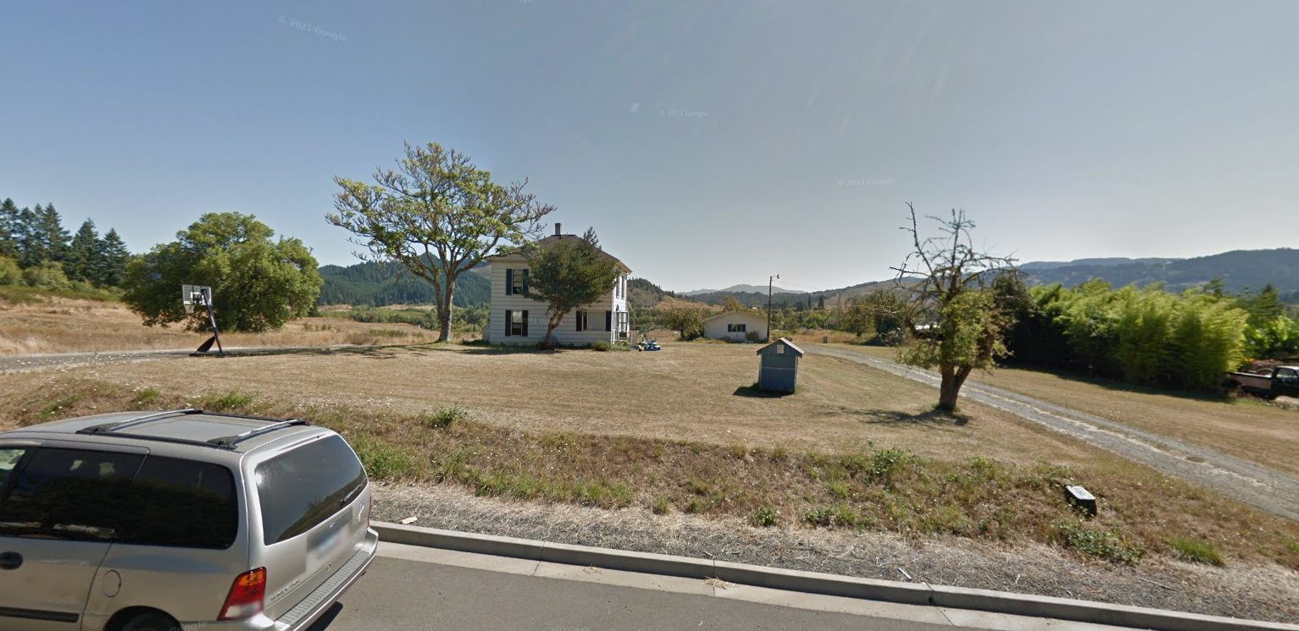

Slide 29
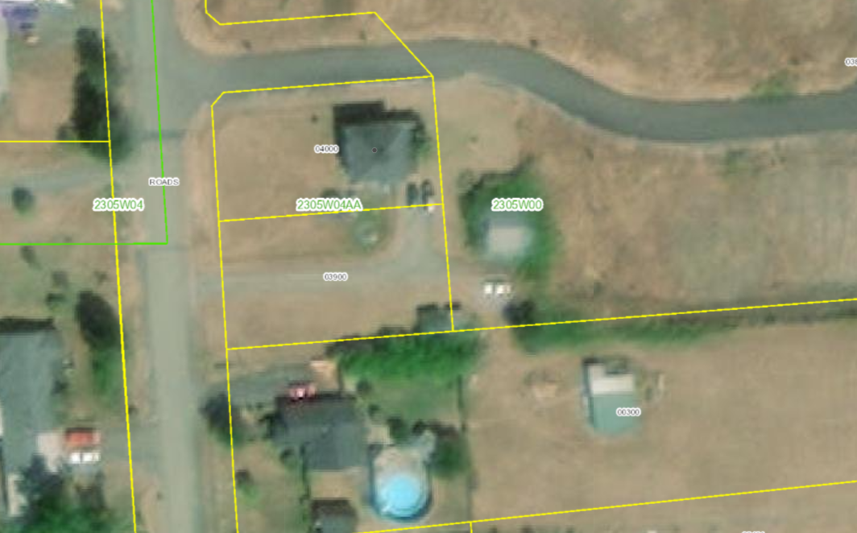

Slide 30
Challenges with Client solution
What is the plan for Title Insurance?
If allocated, will the lender approve the owner’s policy amount being reflected as a lower amount on the prelim?
In most cases, a lower sales prices on the prelim will raise Red Flags with a Lender
I wonder what the appraisal reflected?

Slide 31
Another Possible Solution
Has anyone spoken with the Lenders Underwriter to discuss the problem?
FHA Waiver?
This is the best answer! It allows both lots to be on the loan and for the transaction to be closed in a normal manner
Have your Broker loop in Underwriting.
A direct conversation early in the Transaction is the best path to a solution!

Slide 32
POWERS OF ATTORNEY

Slide 33
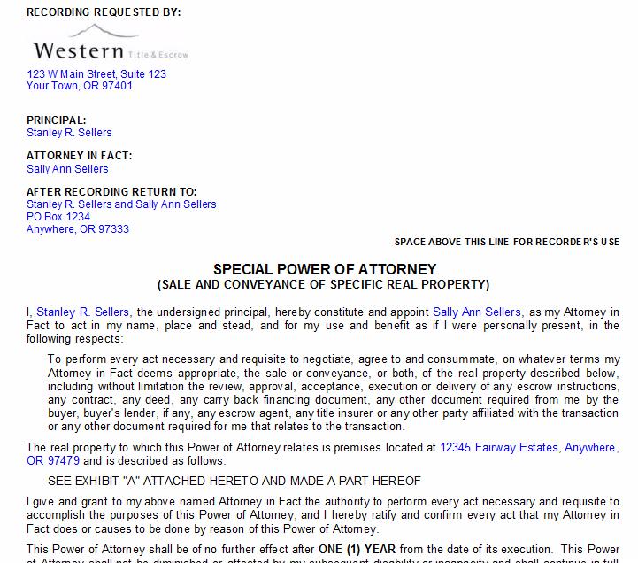
Power of Attorney
Why all the questions??
Breach of Fiduciary Duty
Fraud
Forgery
Elder Abuse
A Misunderstanding

Slide 34
Power of Attorney
Why is a Power of Attorney being used?
Health?
Convenience?
Competence?
Traveling? Out of the Country?
If signing a new Power of Attorney, how will it be notarized?

Slide 35
Power of Attorney
How/where was it signed and notarized?
Competency?
Was it handled by an attorney?

Slide 36
Power of Attorney
Have you spoken with the Principal?
Why not? The answer can be crucial in identifying risks.
Opportunity to verify their understanding and terms of the transaction.
If using a recent Power of Attorney, an answer of NO may raise some red flags.

Slide 37
Power of Attorney
Is it self-serving? Where are the proceeds going?
Self-serving use should be an immediate red flag.
red flag
Self-serving can be as obvious as deeding property to one’s own self.
Can also happen when funds are disbursed to parties other than the Principal.

Slide 38
Power of Attorney
Why is it important to have the Power of Attorney reviewed ahead of time ?
Does the Power of Attorney have any limitations on use?

Slide 39
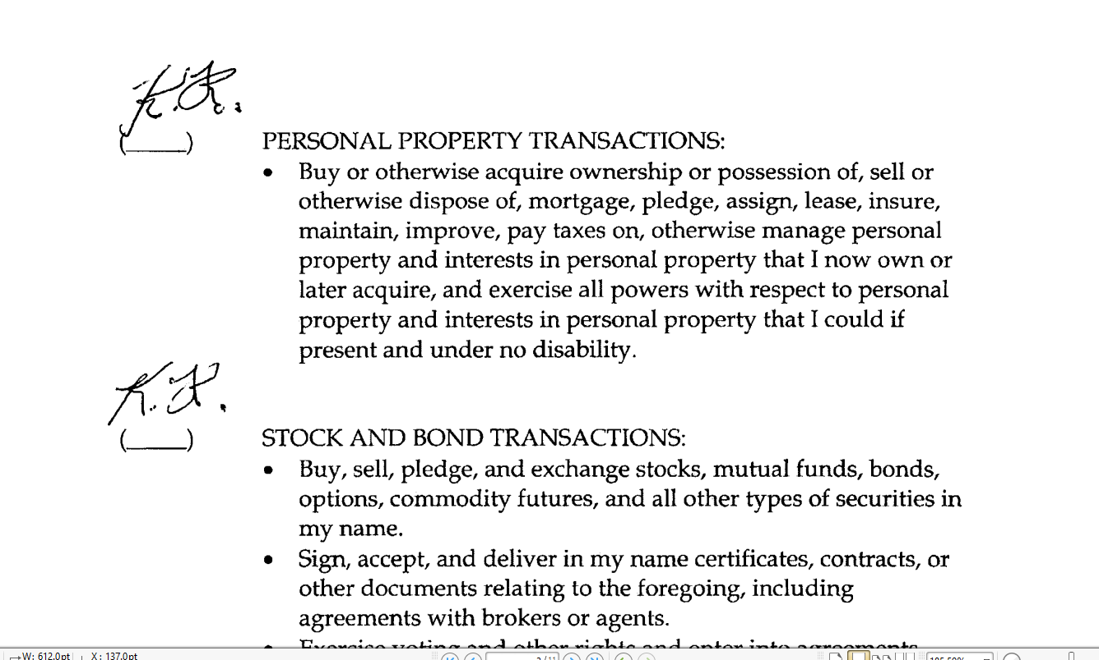

Slide 40
Power of Attorney
Do you have the original to record?
How do you know it hasn’t been revoked?
Why can’t we rely on a copy?

Slide 41
Power of Attorney
93.670 Power of attorney and executory contract for sale or purchase of lands; recordability; effect as evidence; revocation. (1) Every letter of attorney, or other instrument containing a power to convey lands, as agent or attorney for the owner of such lands, and every executory contract for the sale or purchase of lands, when acknowledged or proved in the manner prescribed for the acknowledgment or proof of conveyances, may be recorded in the county clerk’s office of any county in which the lands to which such power or contract relates is situated. When so acknowledged or proved, such letter, instrument or contract, and the record thereof when recorded, or the certified transcript of such record, may be read in evidence in any court in this state without further proof of the same.
(2) No letter of attorney, or other instrument so recorded, is deemed to be revoked by any act of the party by whom it was executed unless the instrument containing such revocation is also recorded in the same office in which the instrument containing the power was recorded.

Slide 42
Power of Attorney
Will the county clerk require it?
In some counties, the clerk will not record a document that has been signed using a Power of Attorney unless the Power of Attorney is also of record in that county.
They are bringing the Power of Attorney with them to the signing…..

Slide 43
Power of Attorney
Can we speak with other family members?
A corroborating conversation with a sibling can go a long way towards making one feel better about a transaction.

Slide 44
Power of Attorney
Who signed the Sales Agreement?
Did the Principal execute the Sales Agreement?
How was the Sales agreement signed? Via DocuSign?
If DocuSigned, what email address was it sent to?
Has anyone spoken with the Principal personally?

Slide 45
Power of Attorney
How is the property vested?
If vested in a Trust or a Corporation, a Power of Attorney may not be appropriate.
In most cases, a Power of Attorney is not appropriate for a fiduciary role.

Slide 46
Questions?

