Slide 1
Deeds
The good the bad and the ugly
Presented by:
Ian Kyle, Underwriting Counsel
Dulce Phelps, Underwriting Counsel for Stewart Title Guaranty Company

Slide 2
Requirements for a valid transfer via deed
Designation of Parties
Writing
Words of Conveyance
Legal Description
Consideration
Execution and Acknowledgement
Delivery and Acceptance

Slide 3
Designation of parties –
GRANTOR
They must sign the document
Maintaining a clear of chain title
Grantor on this deed should be the person or entity who was the Grantee on your last deed. If there is a name change you should include a short explanation; such as “Monica Bing who acquired title as Monica Geller”
Per ORS 93.120 Any conveyance of real estate passes all the estate of the grantor, unless the intent to pass a lesser estate appears by express terms, or is necessarily implied in the terms of the grant
Considerations with the Grantor:
-Minor
-Incompetent
-Alien
-Debtor in a Bankruptcy
-Attorney in Fact
-Legal Entity: Corporation, LLC, Partnership, Trust etc.
-Pending legal proceedings
-Conservatorship / Guardianship/Divorce
-Deceased Owner

Slide 4
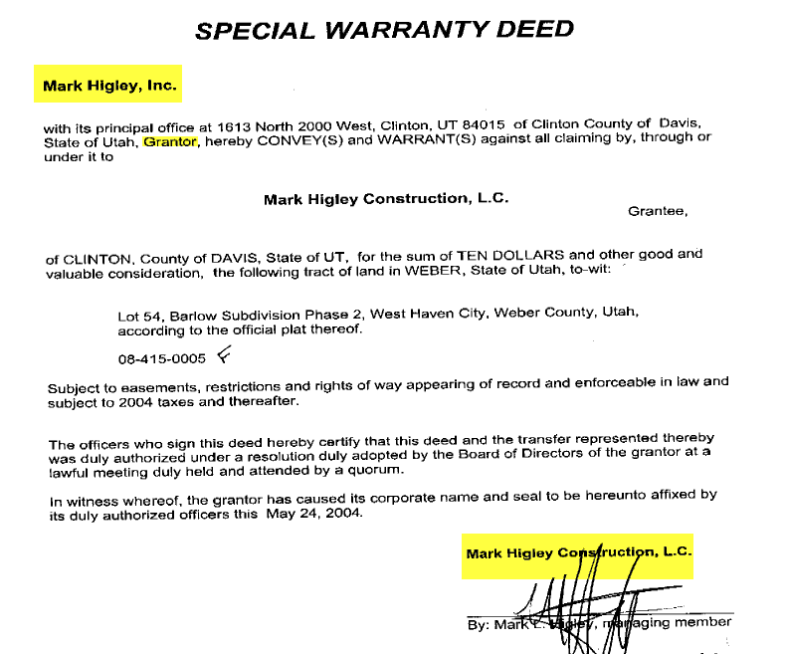

Slide 5
Designation of parties continued
GRANTEE –
your deed must contain a grantee or the deed is void, the grantee must also be capable of taking title (a person or entity that is in existence)
For example you can’t deed to a fence post
Considerations with the Grantee:
--Legal Entity: Corporation, LLC, Partnership, Trust etc. that has been properly created
-Deceased Party

Slide 6
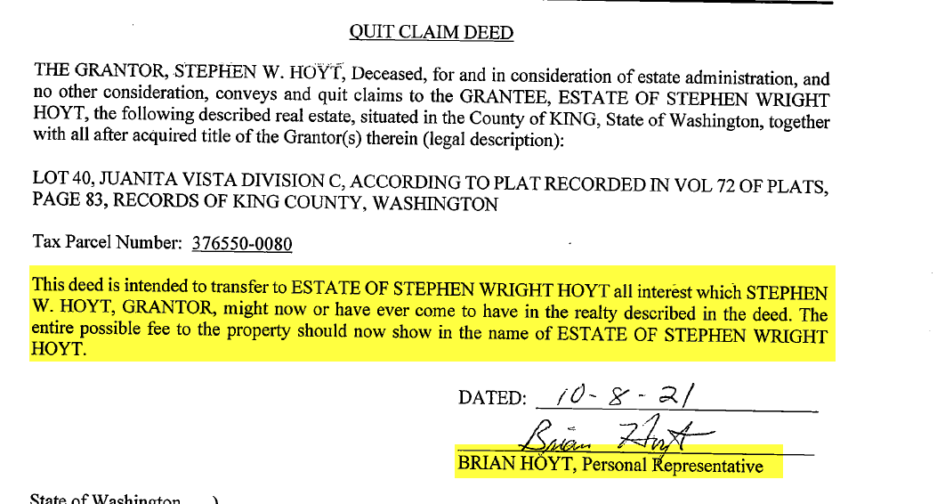

Slide 7
Designation of parties continued
TENANCY - Various ways to hold title
Per ORS 93.180 - A conveyance or devise of real property, or an interest in real property, that is made to two or more persons:
tenants in common
Deed to 2 or more persons without further designation
tenants by the entirety
Deed to spouses married to each other unless the conveyance or devise clearly and expressly declares otherwise
rights of survivorship
Magic words – not as tenants in common but with rights of survivorship
Joint tenancy abolished in Oregon; instead life estate with cross contingent remainders
single entity (such as a corporation)
Title is held by the entity, not the shareholders, members, partners

Slide 8
Writing - Both the statute of frauds and ORS 96.020 require that your deed must be in writing

Slide 9
Words of Conveyance
clear and unequivocal manifestation of a present intent to convey, for example:
Key phrases on a Warranty Deed:
-Warrants and Conveys
-Grant and Convey
-Grant, Bargain and Sell
-Sell and Convey
Key phrases on a Quit Claim Deed
-Remise, Release, Quitclaim and Convey

Slide 10
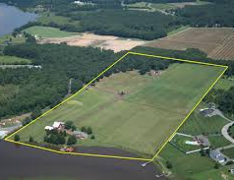
Description of property -
Sufficient to permit its location on the ground with a legally sufficient degree of certainty. Cannot use tax lot numbers, addresses, etc.
Types of descriptions – metes & bounds, lot & block, aliquot parts, deed reference
Limit on premises conveyed – ½ interest, severed improvements, or even timber

Slide 11
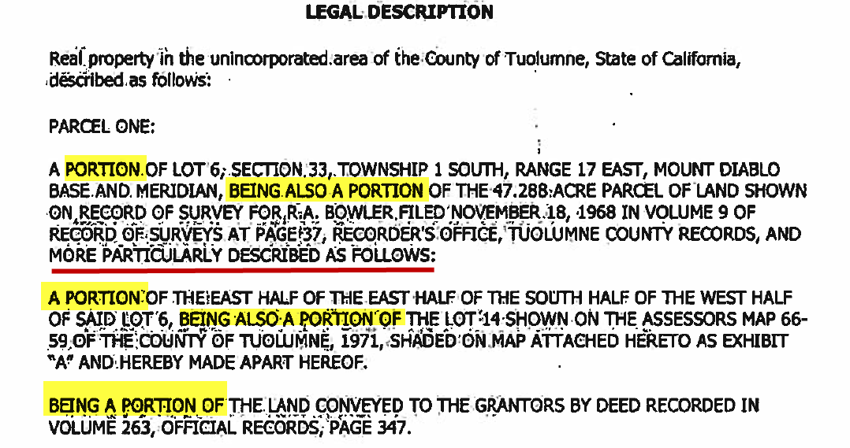

Slide 12
Consideration –
a statement for the actual consideration paid.
Required by recording statutes.
either dollars, any outstanding balance on a mortgage being assumed, or other property.
Oregon statutes will not allow a deed to fail for lack of a statement of consideration.
ORS 93.030 (2)
All instruments conveying or contracting to convey fee title to any real estate, and all memoranda of such instruments, shall state on the face of the instruments the true and actual consideration paid for the transfer, stated in terms of dollars. However, if the actual consideration consists of or includes other property or other value given or promised, neither the monetary value nor a description of the other property or value need be stated so long as it is noted on the face of the instrument that other property or value was either part or the whole consideration.

Slide 13
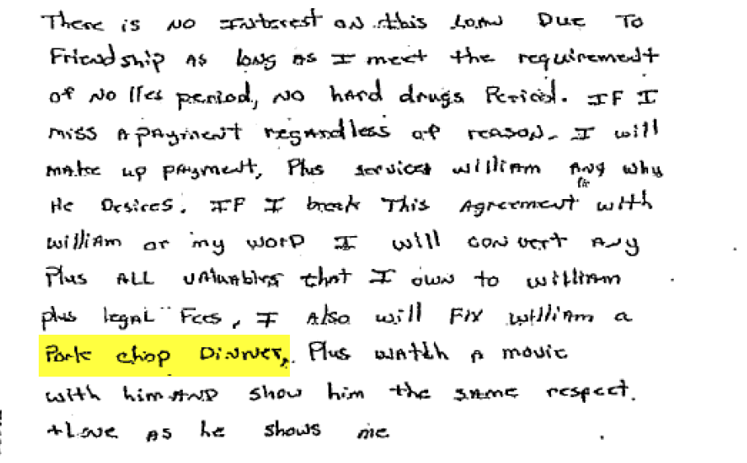

Slide 14
Execution and acknowledgment
Signor must have capacity and, if entity, must have authority to act
Acknowledgement (notary) – not required to make the deed valid, but per ORS 93.410 if the deed is to be recorded in the public record, it must be acknowledged before any judge of the Supreme Court, circuit judge, county judge, justice of the peace or notary public within the state.

Slide 15
Entity Signature Lines
We need to drill down until we reach a real person.

Slide 16
SAMPLE
Central Perk, LLC, a New York limited liability company
By: Bing Holdings, LLC, its Manager
By: Geller Investments, LLC, its Managing Member
By: Buffay Management Inc., its Sole Member
By: ________________________________
Phoebe Buffay, its President

Slide 17
Delivery and Acceptance
DELIVERY is giving dominion and control, some act
of the grantor signaling that the deed is operative and
out of his or her control.
Key is intent.
1. physical delivery and intent
2. recording
3. escrow – placing deed into hands
of 3rd party with instructions
ACCEPTANCE
Rebuttable presumption of acceptance if transfer beneficial to grantee.
By statute, public entities in Oregon must acknowledge deeds as grantee in order for them to be recorded. ORS 93.808

Slide 18
QCD
BSD
WD
SPECIAL WD
FULFILLMENT DEED
FIDUCIARY DEED
TODD
Deed Types

Slide 19
Quitclaim Deed
Passes whatever interest the grantor has on the date signed, NOT the date recorded.
Does not pass after acquired title that grantor may get in the property at a later date.
Typically used where someone is trying to clear an interest from the property (e.g., interest of ex-spouse)
Does not deny the grantee status of a good faith purchaser

Slide 20
Bargain & Sale Deed
Passes all interest the grantor has or may acquire later in the property, meaning that it passes after-acquired title. However, it does not give any warranties as to the status of the title to the property.
Used in situations where grantor does not want to expose himself to representations of the title.

Slide 21
Special
Warranty Deed
Passes all interest the grantor has or may acquire later in the property, meaning that it passes after-acquired title. Grantor Warrants title is free of encumbrances created or suffered by the grantor except as specifically set forth in the deed. ORS 93.855

Slide 22
Warranty Deed
Passes all interest the grantor has or may acquire later in the property, meaning that it passes after-acquired title. It also makes specific representations as to the title of the property, called warranties.
These warranties include:
grantor has all the estate in the property they purport to convey
grantor is seized (legal possessor of) the estate or interest conveyed
grantor will defend the title against a third party
property is free from encumbrances, except those specifically enumerated.
Title Companies prefer warranty deeds because of the right of subrogation

Slide 23
Fulfillment deeds
Used when a contract is paid off, and seller is conveying title to the buyer.
The warranties are limited to only those created by the seller - there are no warranties for any defects to the title that the buyer placed upon the property.
Generally, most contracts will call for a special warranty deed to fulfill a contract. But if the contract is silent as to the type of deed, a quitclaim or bargain and sale may be used. However, a quitclaim deed should not be used with a collection escrow.

Slide 24
Fiduciary deeds
Trustees deed – by this I mean a deed given by successor trustee of a revocable trust (not in a foreclosure situation)
Typically, a type bargain & sale deed because a successor trustee lacks the requisite knowledge to warrant title
Personal Representatives Deed, Conservators Deed
Deeds used in conjunction with court proceedings basically, a form of bargain and sale deed, used by either a personal representative in a probate, an affiant in a small estate or a conservator in a conservatorship.
Grantors are not title holders to the real property.
Heirs or devisees or the protected person holds title
Must comply with court procedures – such as the 4 month claim/challenge period in small estate or probate

Slide 25
Transfer on Death Deed
In 2012, Oregon Adopted the Uniform Transfer on Death Act
Allows of use of TOD Deed, which is a type of bargain and sale deed
Names Beneficiary(ies) who take title upon death of grantor
Must be recorded before the transferor’s death
Must convey to specific beneficiary
TOD Deed can be revoked by a subsequent transfer or new TOD Deed
Problem: 18 month period for challenge of creditors and heirs or devisees

Slide 26
COMMON ERRORS
GRANTOR/GRANTEE
Spelling of names, including middle initials and nick-names
Missing a spouse in grantor clause, trusting software
Omission of tenancy
Address for tax notices
LEGAL DESCRIPTIONS
1. Typographical Errors
2. Missing Tie Leg or monuments on metes and bounds descriptions
3. Ambiguous description
4. Incomplete and doesn’t close
5. Bearings with errors in degrees, minutes, seconds
ACKNOWLEDGEMENTS
Not including each of the signors
Individual acknowledgment for a business
Witness date being different than notarized date
Tracking the entity authority

