Slide 1
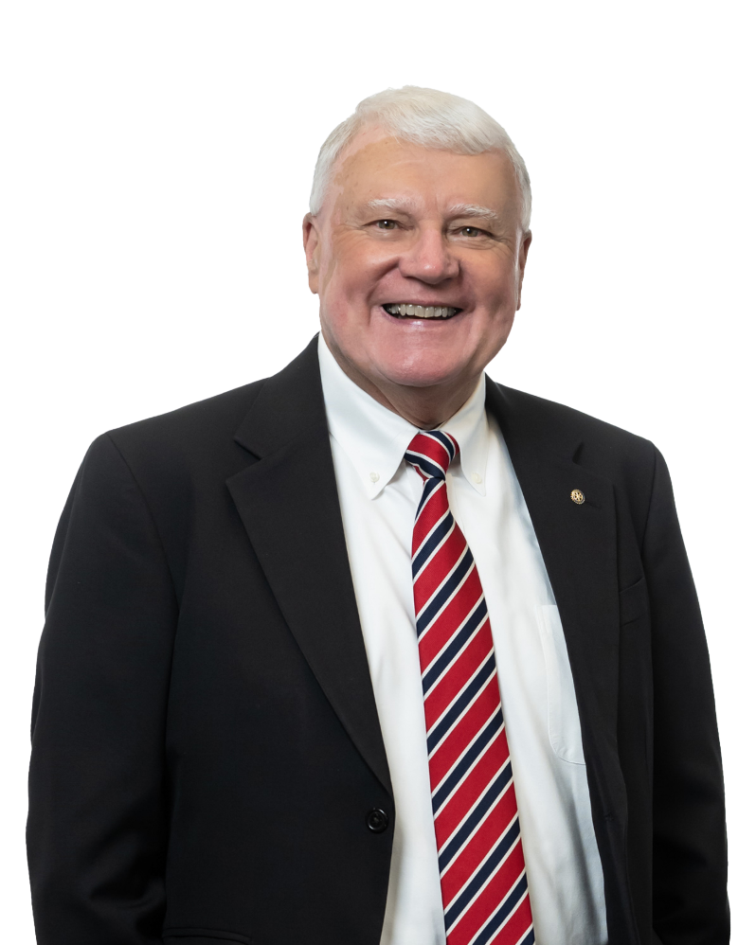
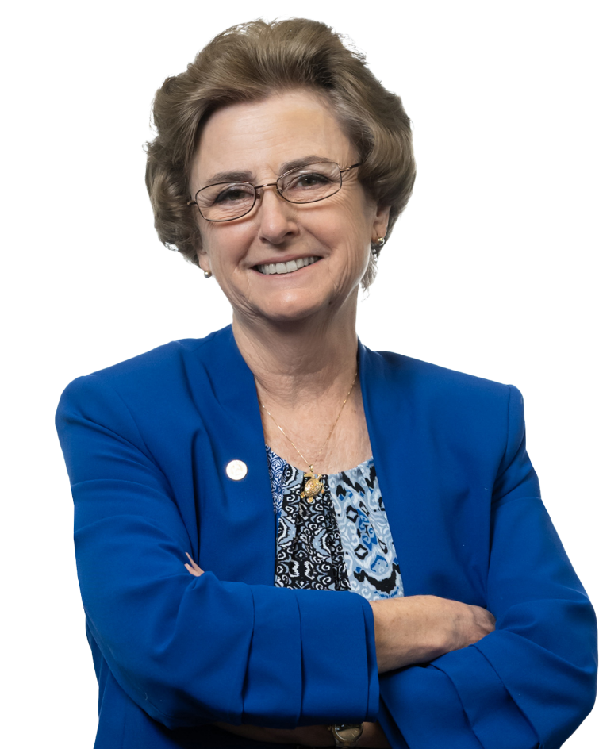
Bob Brandon
Peggy Neikirk
on behalf of your partners
at Lawyers Title
Low Income Housing Transactions

Slide 2
Preparation of the Land
& Title Issues
Use of Title Plant Records Reports
Clients resolve Legal Lot status
Assembling Properties (page 3)
Property Line Adjustments (page 4)
Partition Plats (page 5-6)
Initial Preliminary Title Report

Slide 3
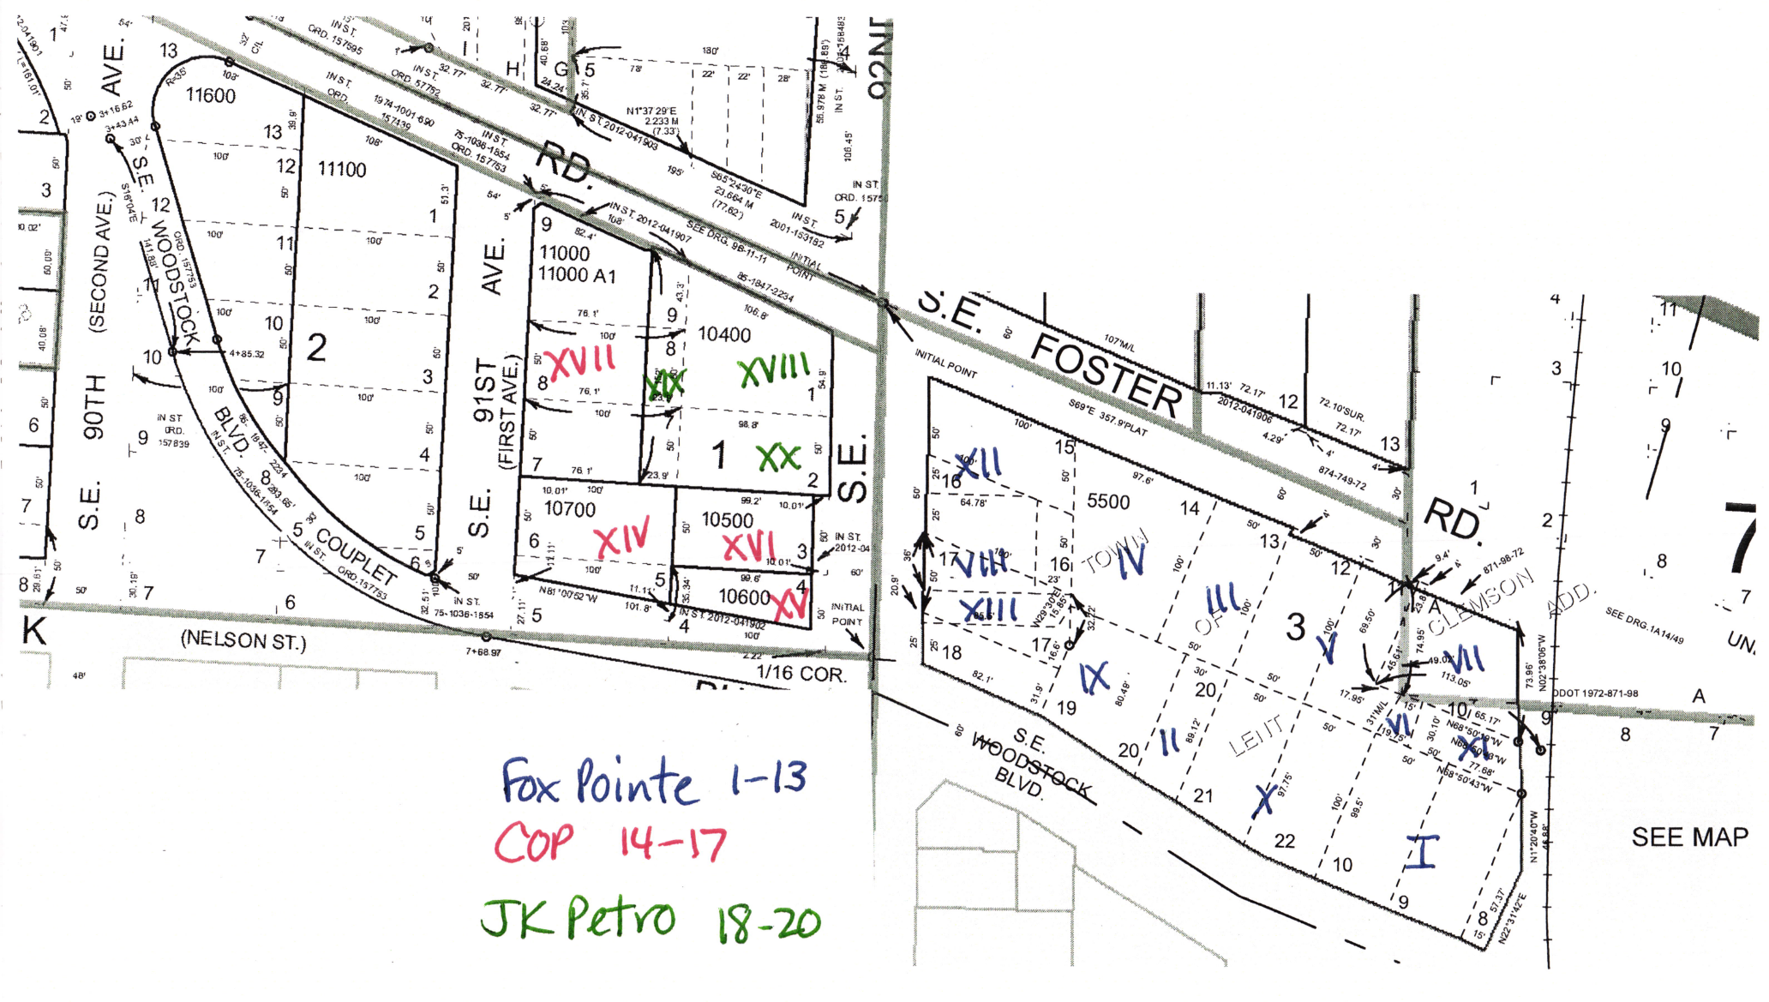
Assembling Properties

Slide 4
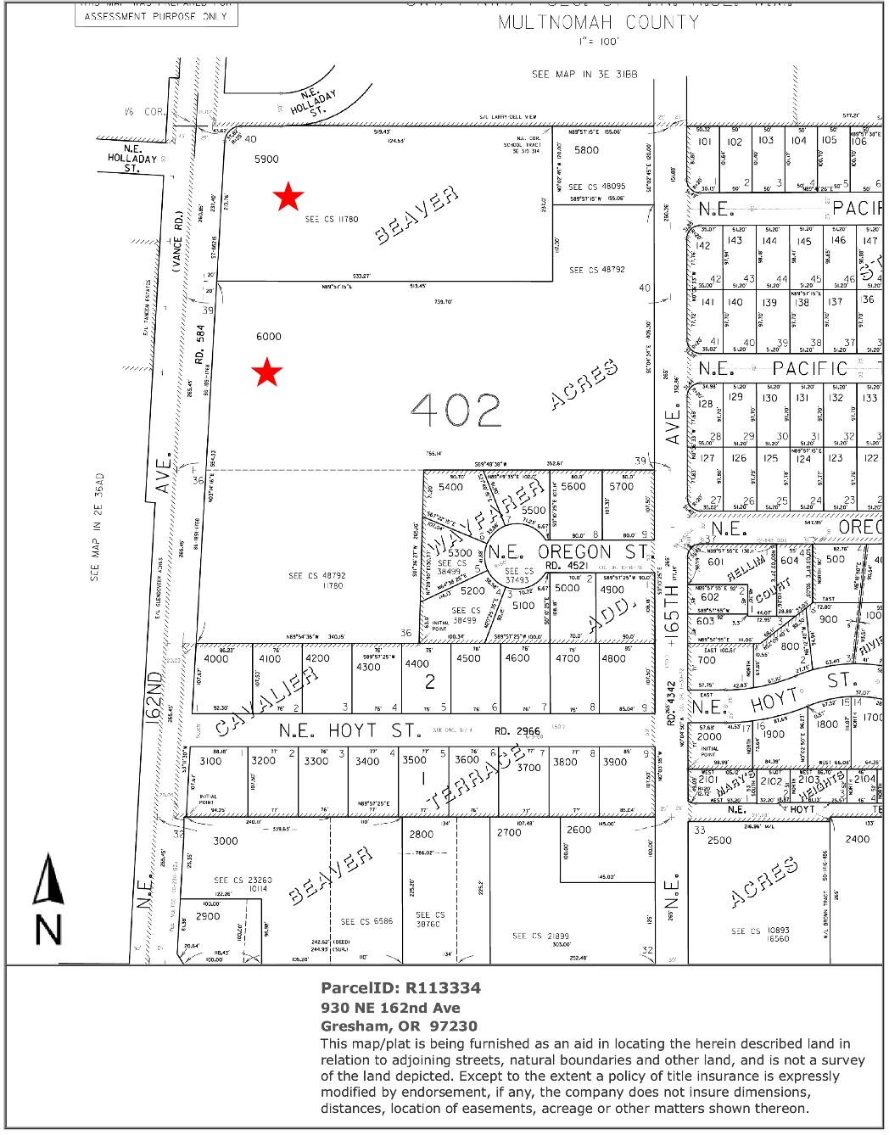
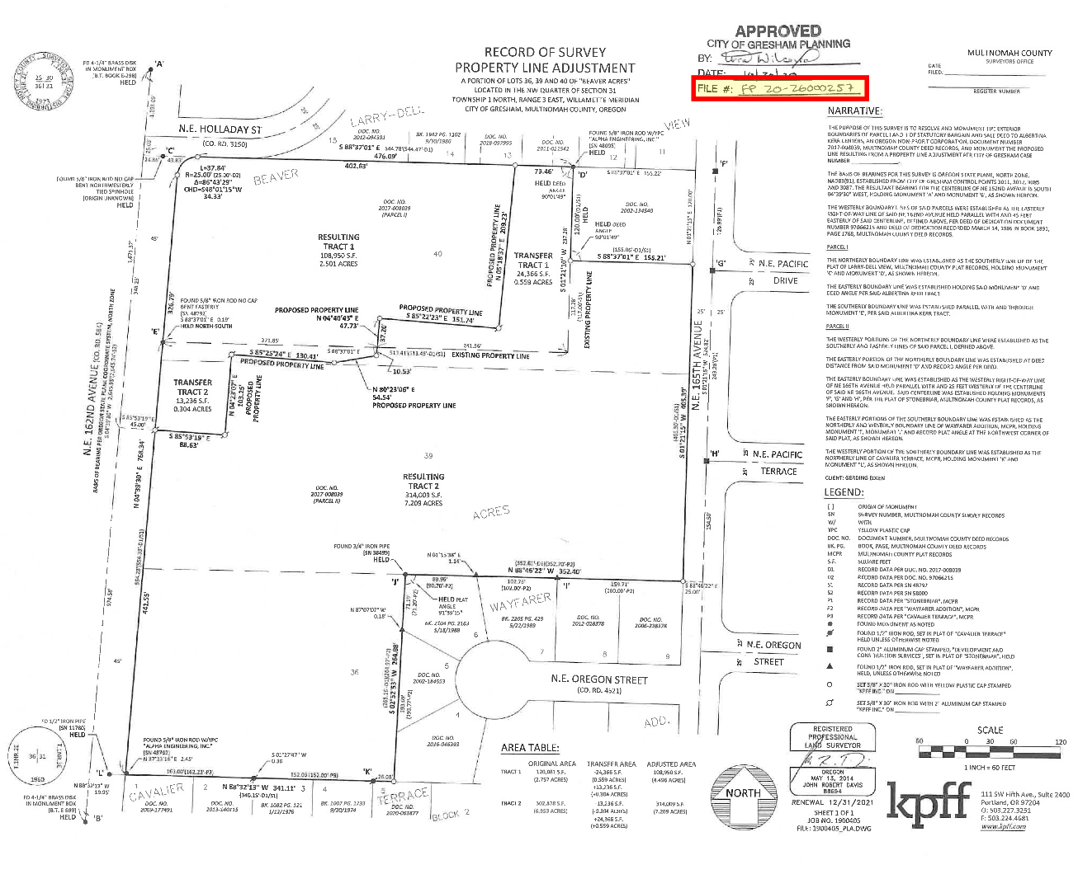
Property Line Adjustments

Slide 5
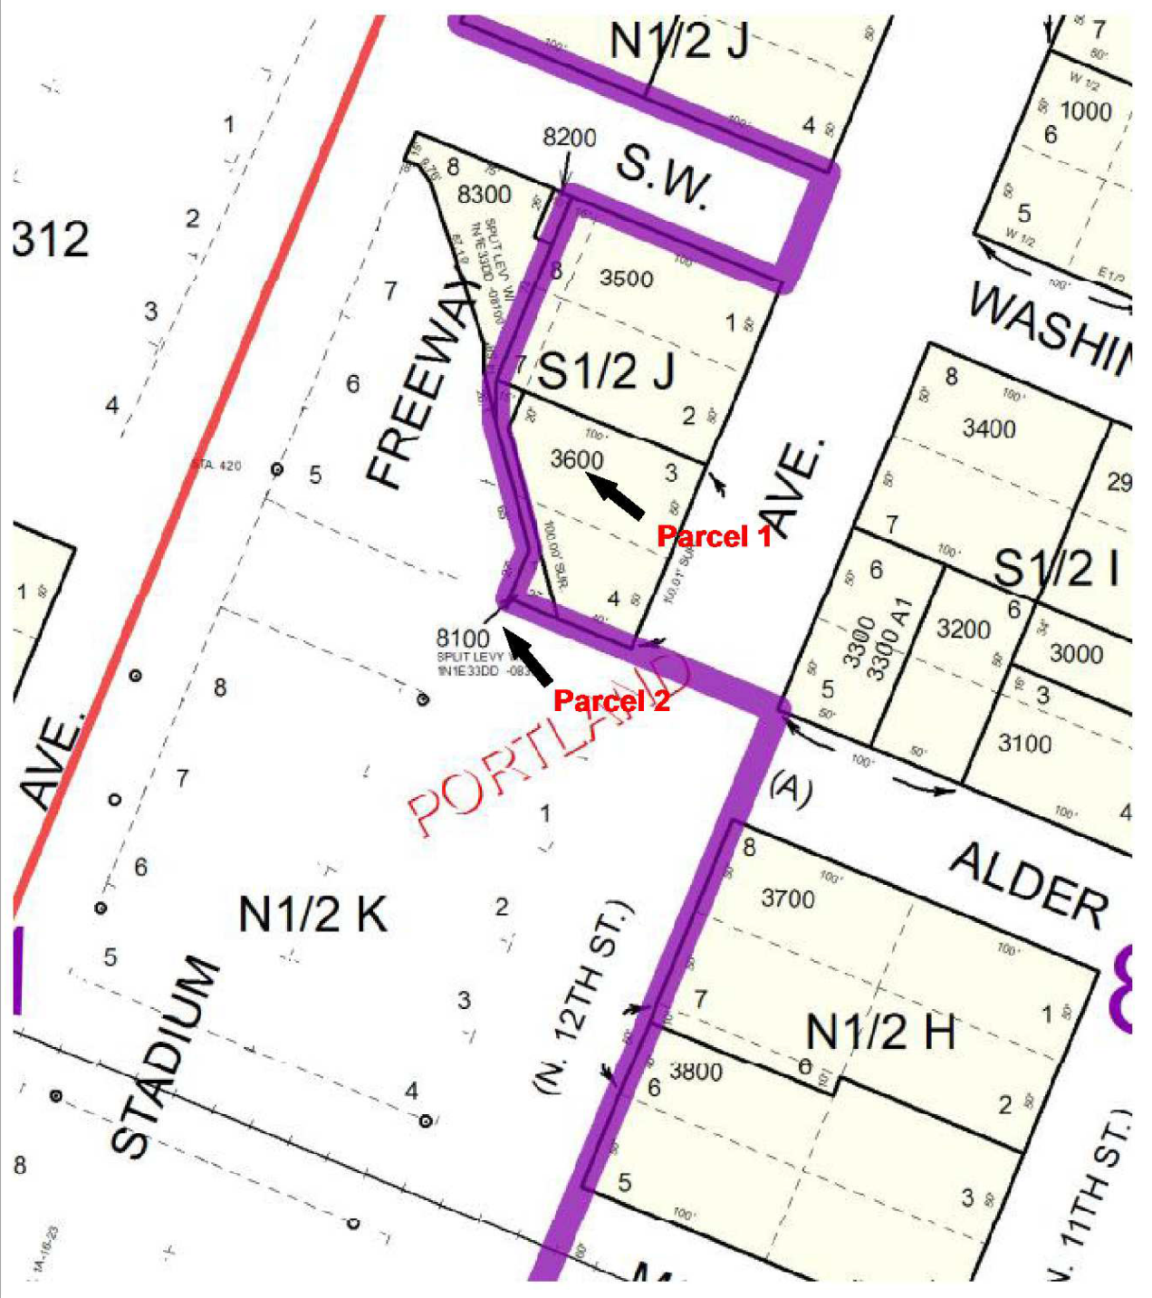
Partition Plats

Slide 6
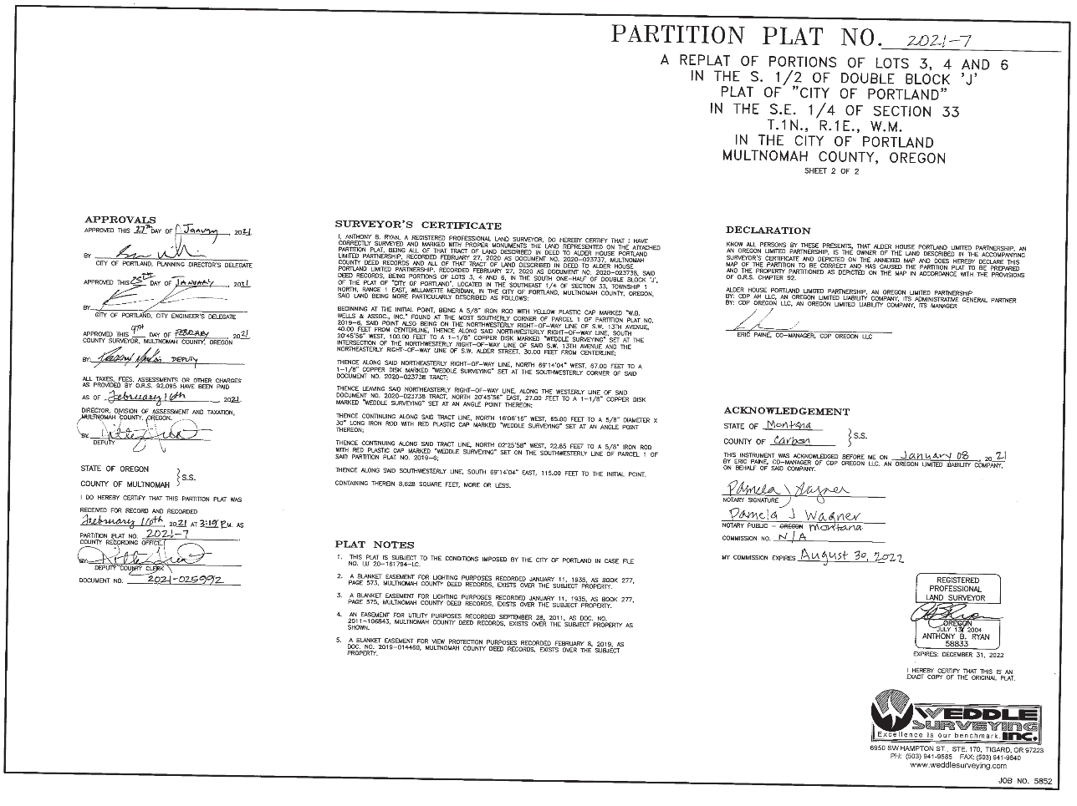
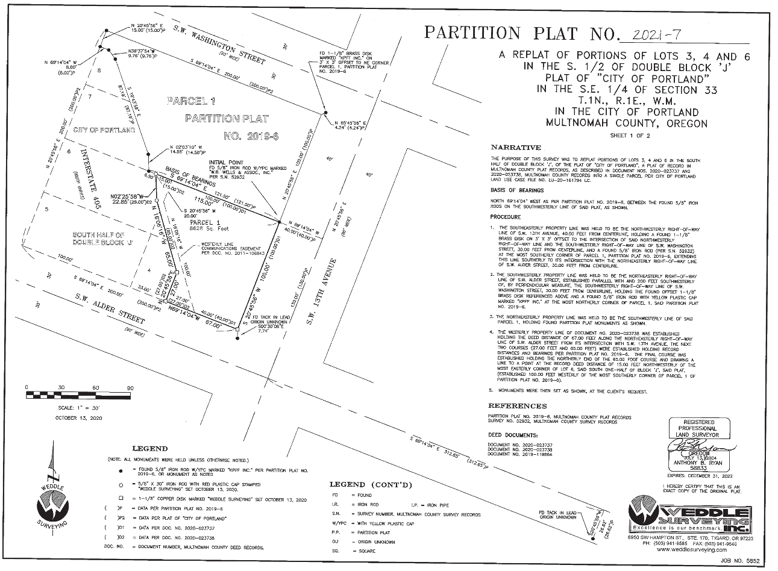
Partition Plats

Slide 7
Massive Calls
(60+ people)
Multiple sources of revenue:
Construction Lender
Permanent Lender
Bonds
Grants
Equity Investors
Sponsor Loans
$100 equity from managers
Counsels for all of the above, principals and the Trustee
Taking notes and filling in the blanks for what they have vs what you need
Closing Checklists from both Bond Counsel and Lender Counsels
Common: Developer
503(c)3 type entity (NAYA, Hacienda etc.)

Slide 8
Massive Documents
TEFRA hearings
Section 8
(“Tax Equity and Fiscal Responsibility Act”) -Public Inquiry required by IRS of Non-profit borrowers that intend to issue tax-exempt debt
“AHAP” (Agreement to enter into housing assistance payments)-HUD
Governors’ Approval
Regulatory Agreements

Slide 9
Forward commitments and purchase
(take out loan)
“Seller”
“Purchaser”
“Borrower”
is trustee for OHCS (State of Oregon) who provided the bond funds (governmental lender)
is the long-term bank-Permanent loan
is the owner of the project

Slide 10
Recording and Priority of Documents
Conventional (taxable Loan documents) vs the bonds etc.
Batch recordings with completion of prior document recording numbers in them
1
3
Recording of LIHTC documents and covenants (with attachments)
Priority Agreement last that sets forth everyone’s agreed upon interests
2
4

Slide 11
Welch Port Apartments
Welch Port Limited Partnership
(an Oregon limited liability company)
BORROWER
Managing General Partner (0.004%)
HALC Welch GP LLC
Special Limited Partner (0.001%)
Housing Authority of Lexus County
Administrative General Partner (0.005%)
Stewart Welch LLC
Limited Partner (99.99%)
NOP Assignment Corporation
SPECIAL TITLE REQUIREMENTS
Sole Member (100%)
Housing Authority of Lexus County
Stewart Development LLC
Manager
100%
Member 40%
Greg Smith
Member 40%
Stewart Properties LLC
(Oregon limited liability company)
Member 20%
ABC Real Estate LLC
(Oregon limited liability company)
The Sands Trust
Dated January 28, 2005
Trustees
Bill & Terri Sands
Member 100%
Ana Candell

Slide 12
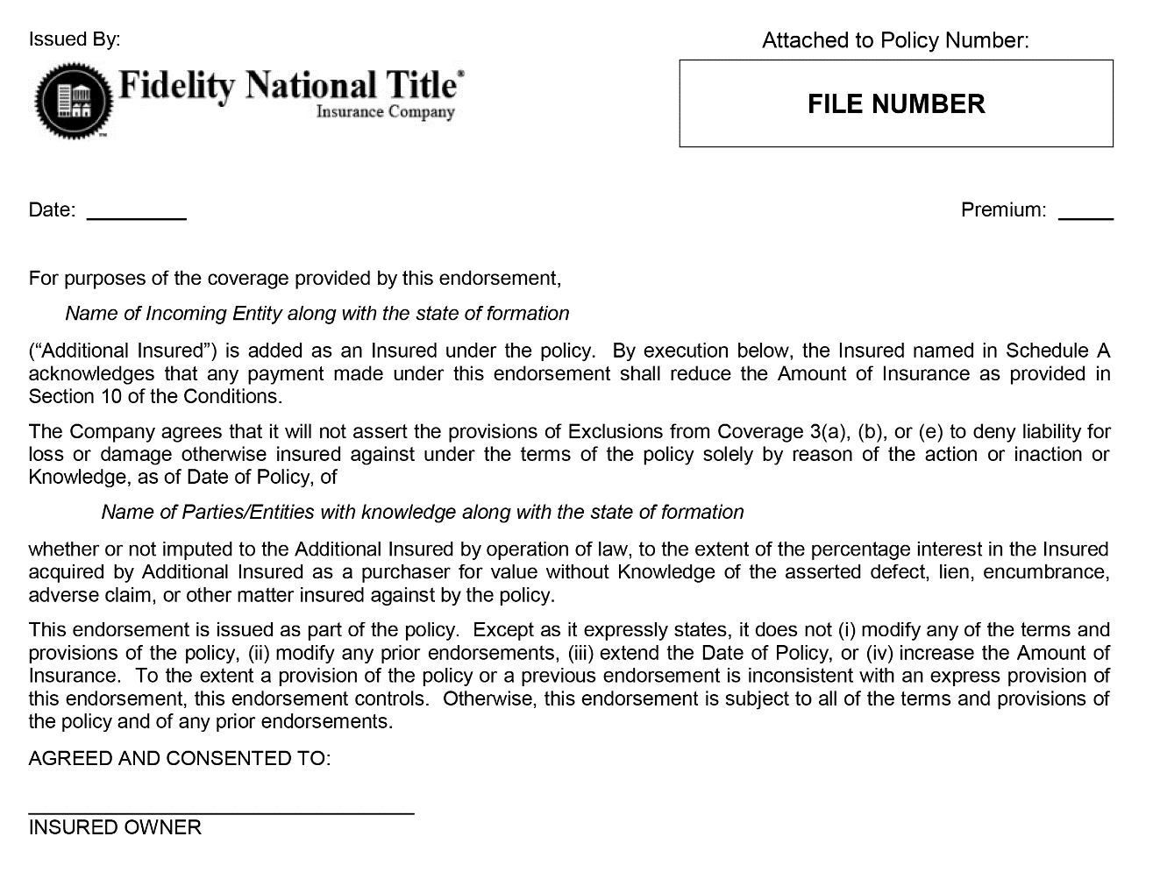
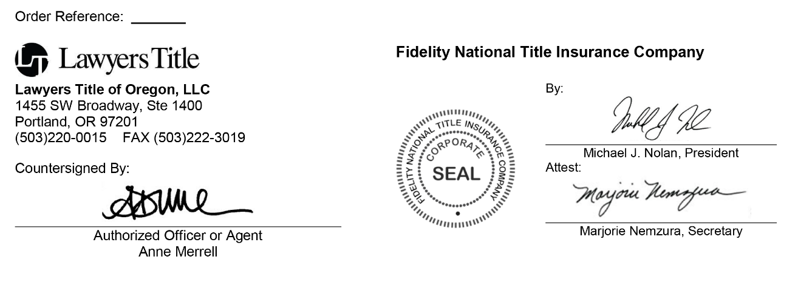
Nonimputation Endorsements:
Affidavits/Indemnities, Financial information, signed endorsements
SPECIAL TITLE REQUIREMENTS

Slide 13
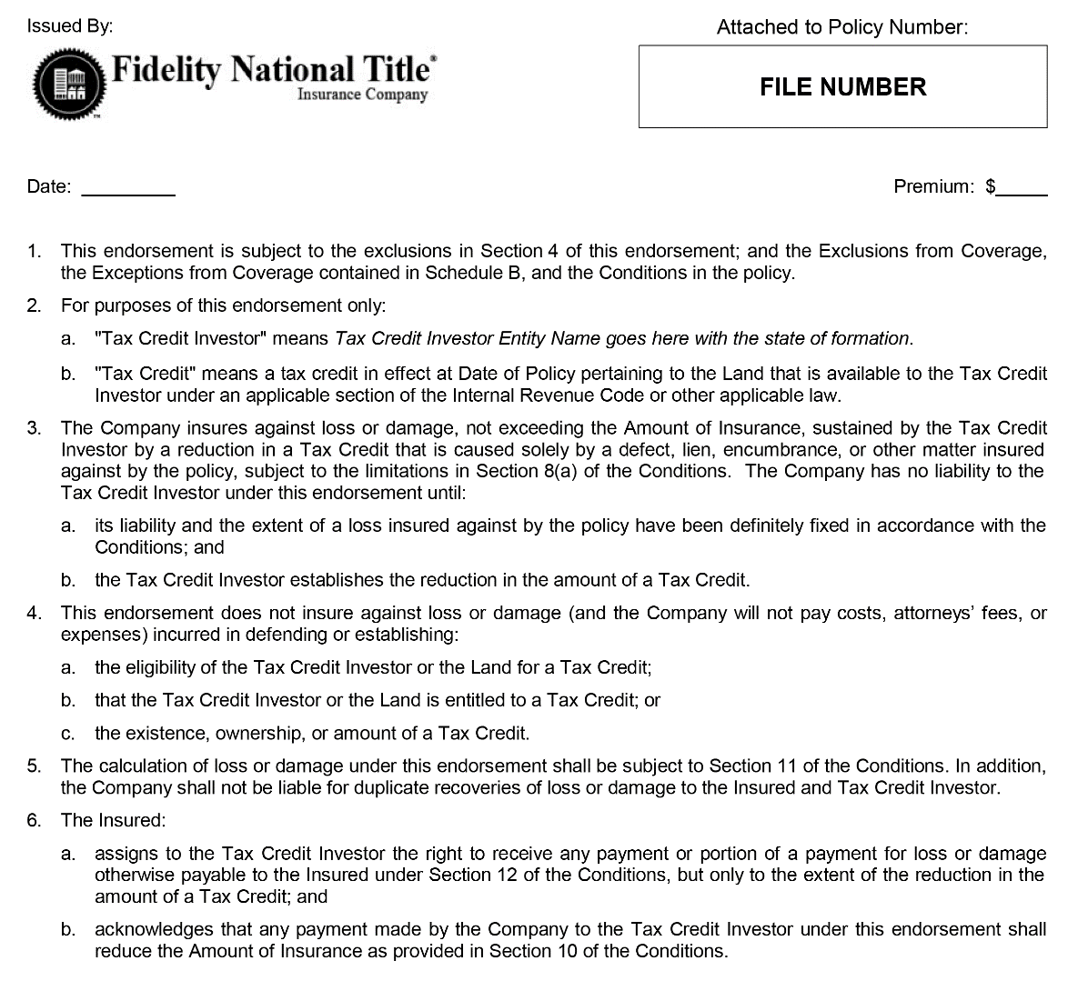
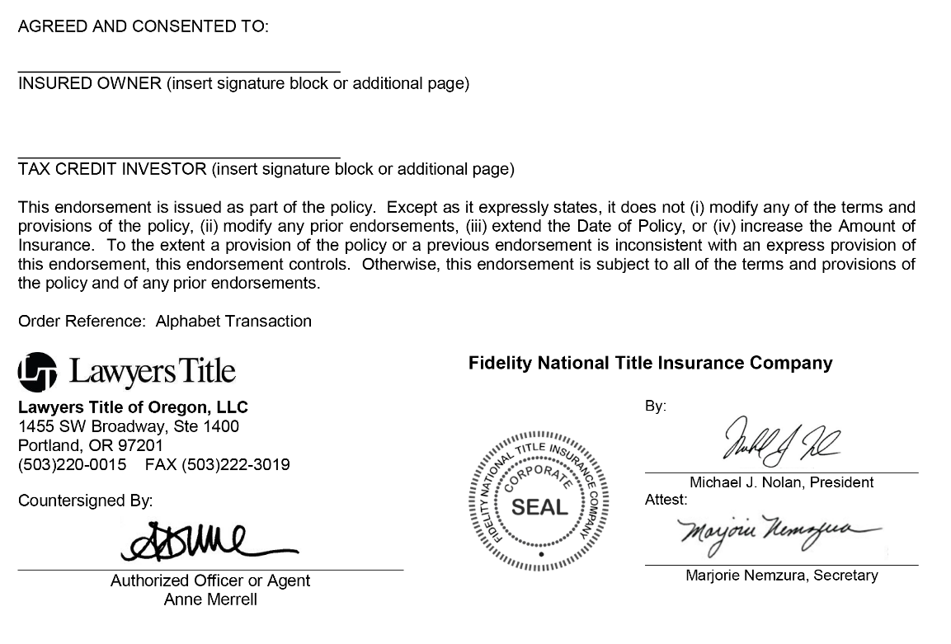
Tax Credit Endorsement
(signed by investor as well as insured)
SPECIAL TITLE REQUIREMENTS

Slide 14
Massive Documents
Private Rights coverage
Certain endorsements generally paid for at closing but issued later
SPECIAL TITLE REQUIREMENTS
Potential ground lease
DDA from the governmental entity granting the land
Construction Lien Endorsement packages–usually two packages for most projects
Elimination of exception endorsements
Underwriting Approvals

Slide 15
Conversions to Permanent Loans
As-built surveys
Condominium Filings (page 16)
Exchange of interests in portions of the land or Condo Units
Amended and Restated Deeds of Trust
New Policies or Additional Policies
Endorsements to existing Policies
Modification: 211
Survey: 225
Utility Access: 217.2
Location of Improvements: 222

Slide 16
Condominium Filings
Example Condo Filing

Slide 17
Bob Brandon
Peggy Neikirk
on behalf of your partners
at Lawyers Title
Thanks for joining!

