Slide 1
SURVEY SAYS: ALTA SURVEYS, SURVEY EXTENDED COVERAGE, AND RELATED ENDORSEMENTS
Presented by:
Brady McGarry, Professional Land Surveyor, Chase Jones & Associates and
Justin Carter, Underwriting Counsel, Chicago Title and Ticor Title

Slide 2
Presentation Roadmap
When is a survey required?
The Mechanics of Survey Coverage
What is an ALTA/NSPS Survey?
Minimum Standards
Table A Optional Items
Discussion of Related Endorsements and Table A Items

Slide 3
When do I need a Survey?
Variations per underwriter
Always: Owner’s Extended Policies
Generally: Lender’s Extended Policies insuring $1,000,000 or more
Exceptions on a case by case basis
No exceptions for farm and ranch land
Typically, no exceptions for new construction
Several Endorsements (maybe):
Covenants, Conditions, Restrictions, Private Rights, Minerals – 209 series
Contiguity - 219s
Access - 217s
Same as Survey - 225 (it has survey in the title)

Slide 4
Mechanics
The survey related exceptions, which are standard exceptions 2-4, are replaced by a specific exception for matters disclosed by the survey.
Standard Exceptions
2. Any facts, rights, interests or claims, which are not shown by the Public Records but which could be ascertained by an inspection of the Land or which may be asserted by persons in possession thereof.
3. Easement, or claims thereof, which are not shown by the Public Records; reservations or exceptions in patents or in Acts authorizing the issuance thereof; water rights, claims or title to water.
4. Any encroachment, encumbrance, violation, variation, or adverse circumstance affecting the Title that would be disclosed by an accurate and complete land survey of the Land.
Replaced by New Exceptions: “Any rights, interest, or claims which may exist or arise by reason of matters disclosed by that ALTA/NSPS Land Title Survey last dated June 24, 2016 by Guy Surveyor, of Surveyor & Associates, P.S. for: (a) storm drain lines connecting to the adjacent Texaco parcel; (b) building line encroaching over the northerly 1.2 feet.”

Slide 5
Mechanics Continued – Policy boilerplate
Covered Risk 2(c) ALTA Owner’s and Loan Policies – A defect in the Title caused by –
2006 Form
2021 Form
Comments

Slide 6
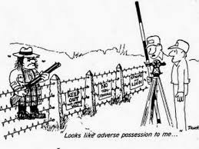
What is an ALTA/NSPS survey?
Meets the minimum standards promulgated by the American Land Title Association and the National Society of Professional Surveyors (formerly the American Congress of Surveying and Mapping)
Minimum Standards Include
Boundary lines
Building footprint
Location of utilities
Location of recorded easements
Evidence of unrecorded rights
Additional Items

Slide 7
ALTA/NSPS Standards
Most recent promulgation: 2021
Minimum Standards
Fieldwork must meet certain technical measurement standards of precision. 3(E).
Depict
monuments found and set (if required) and boundary lines. 5(A)(i-iii).
adjoining streets, access to a public rights of way, and potential unrecorded rights. 5(B)(ii-v).
evidence of possession, significant improvements within 5 ft. of boundary lines, and potential encroachments into easements or setbacks disclosed in documents, 5(C), and buildings, 5(D).

Slide 8
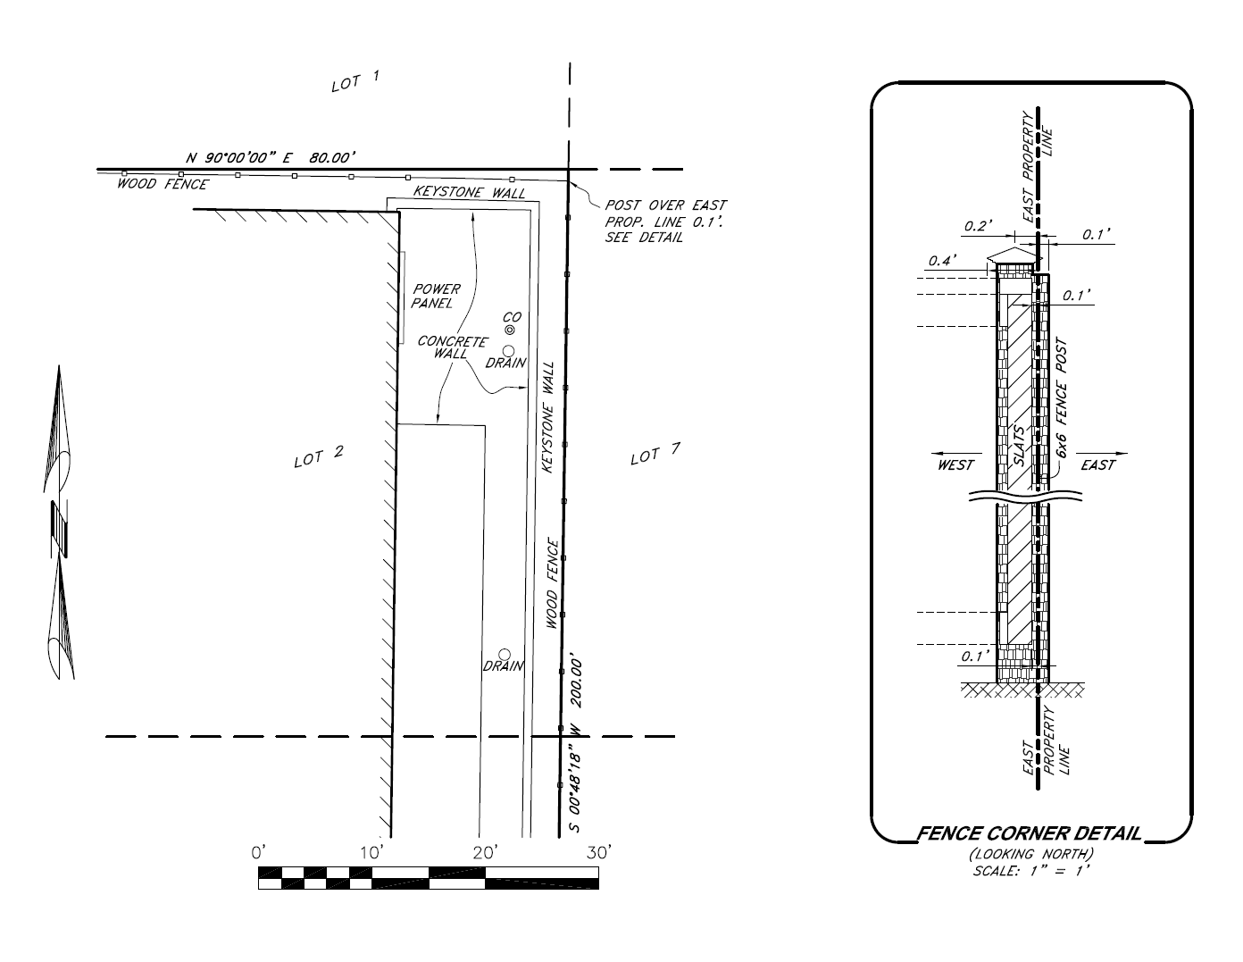
Example Survey Issue: Locating fence corner

Slide 9
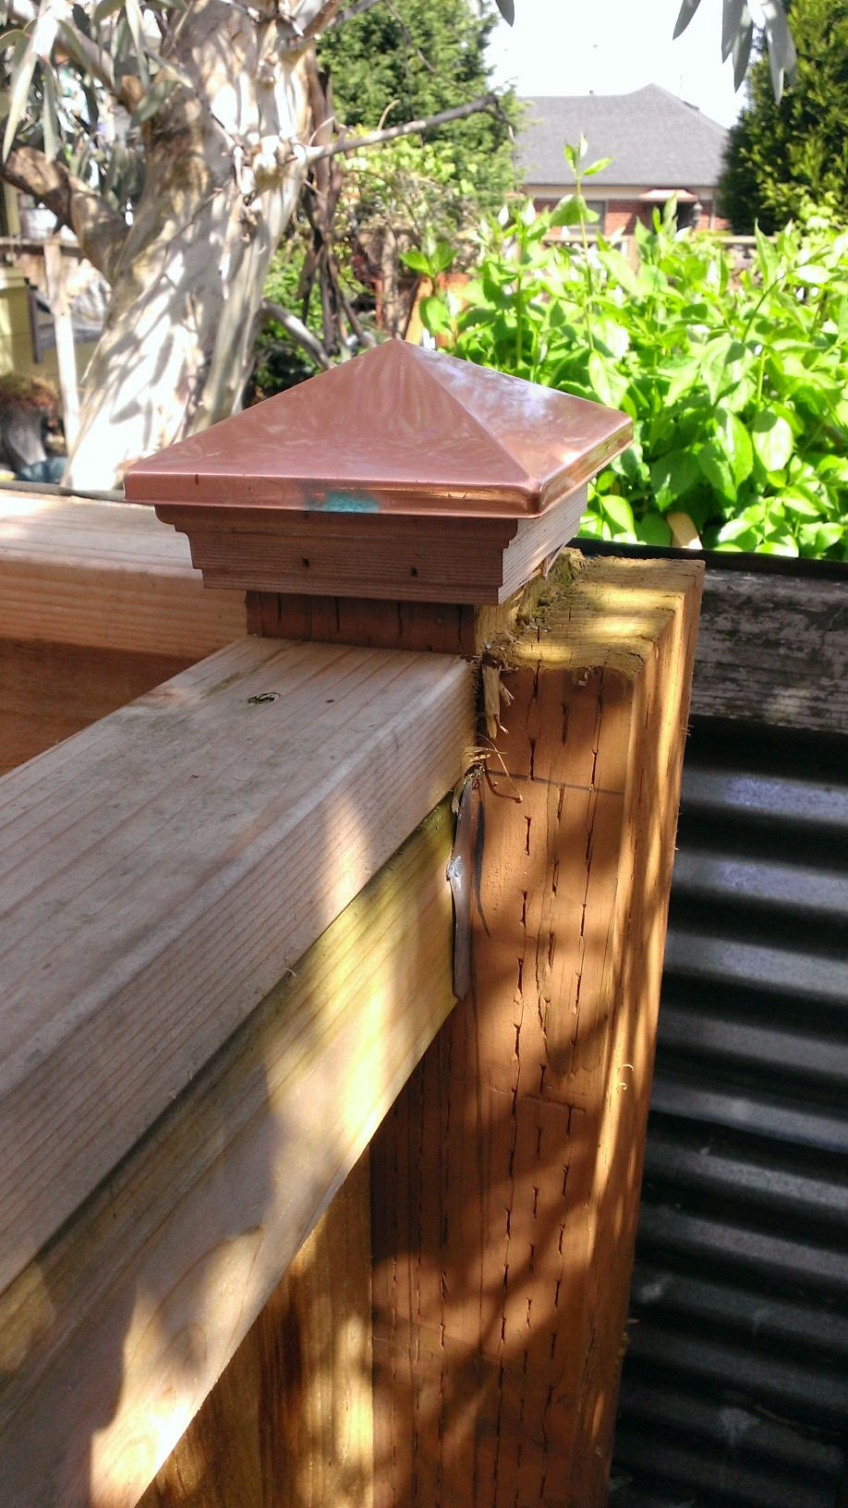

Slide 10
ALTA/NSPS Standards
Most recent promulgation: 2021
Minimum Standards
Fieldwork must meet certain technical measurement standards of precision. 3(E).
Depict
monuments found and set (if required) and boundary lines. 5(A)(i-iii).
adjoining streets, access to a public rights of way, and potential unrecorded rights. 5(B)(ii-v).
evidence of possession, significant improvements within 5 ft. of boundary lines, and potential encroachments into easements or setbacks disclosed in documents, 5(C), and buildings, 5(D).
recorded easements and potential unrecorded easements including utilities and utility locate markings. 5(E)(i-ii).
surface evidence of utilities including utility locate markings, and also utility poles within 10 ft. of boundary lines. 5(E)(iii-iv).
boundary lines with labeled courses, point of beginning, and point of commencement if applicable. 6(B)(iii).
any lack of contiguity (gaps, gores, and overlaps) between the subject property and adjoiners. 6(B)(vii).
building locations labelled perpendicular to property lines. 6(B)(ix).
locations of plottable easements. 6(C)(i).
North arrow, legend, and certification to the insured (buyer/borrower), title company, and the lender. 6(D) & 7.
Optional Table A Items – often required for specific endorsements

Slide 11
Table A
Table A is essentially a request to the surveyor to include certain Items on the survey
Requests are communicated by the customer checking Items on Table A
Some Items are dictated by lender requirements and others by title insurance requirements
Title insurance requirements correlate with specific endorsements

Slide 12
Table A Commonly Requested Items

Slide 13
Table A Commonly Requested Items

Slide 14
Endorsements and ALTA Surveys
Endorsements that will be covered
Zoning Endorsements – OTIRO 203s
Covenants, Conditions, Private Rights, Encroachments - OTIRO 209 series
Access Endorsements – OTIRO 217s
Contiguity Endorsements – OTIRO 219s
Same as Survey Endorsements – OTIRO 225s
Encroachment Endorsements – OTIRO 228s
Table A Items that will be covered
Substantial features observed in the process of conducting fieldwork in addition to those required in Sec. 5. Item 8.
List zoning requirements supplied to the surveyor, Item 6(a), and depict setbacks, if no interpretation required by the surveyor, Item 6(b).
Dimensions, square footage, and height of buildings. Item 7(a) - (c).
Parking spaces. Item 9.
Appurtenant easements. Item 18.
Location of utilities on or serving the property as determined by plans or locate markings. Item 11.
Also several minimum standards will be covered

Slide 15
209 Series and Encroachment Endorsements
Minimum Standards
boundary lines. 5(A)(iii).
potential unrecorded rights. 5(B)(v).
evidence of possession, significant improvements within 5 ft. of boundary lines, buildings, and potential encroachments into easements or setbacks disclosed in documents, 5(C), and buildings 5(D).
recorded easements and potential unrecorded easements including utilities and utility locate markings. 5(E)(i-ii).
surface evidence of utilities including utility locate markings and also utility poles within 10 ft. of boundary lines. 5(E)(iii-iv).
boundary lines with labeled courses, point of beginning, and point of commencement if applicable. 6(B)(iii).
building locations labelled perpendicular to property lines. 6(B)(ix).
locations of plottable easements. 6(C)(i).
Table A Items
Substantial features observed in the process of conducting fieldwork in addition to those required in Sec. 5. Item 8.

Slide 16
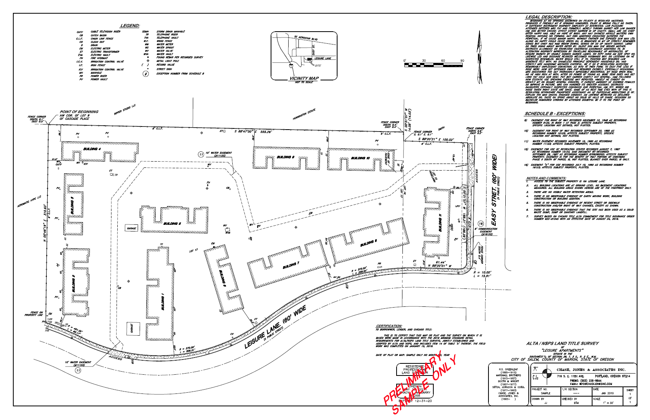
ALTA Survey – without Table A Items

Slide 17
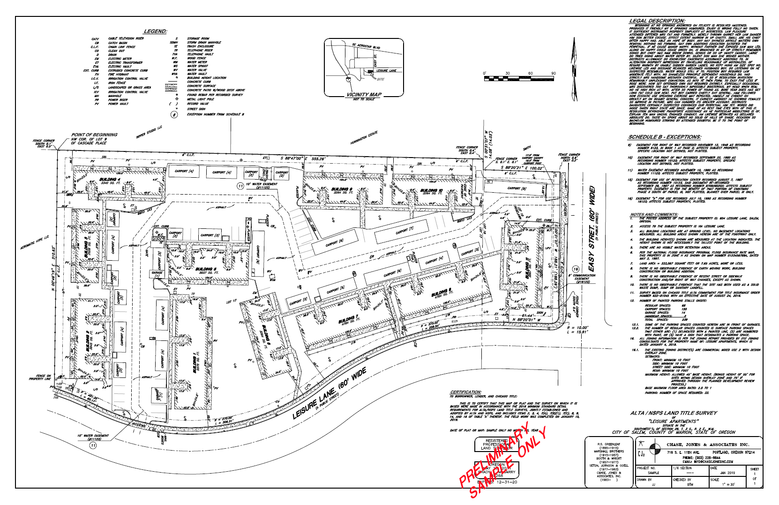
ALTA Survey with “Normal” Table A Items

Slide 18
OTIRO 209 Series
Disclaimer—this is a very broad summary of the 209 series
Generally, insures against loss or damage caused by violations of covenants, conditions, and restrictions unless exception is taken in policy.
Varying definitions of improvement.
Eg. 209.2-06—a building, structure located on the surface of the Land, road, walkway, driveway . . . That by law constitutes real property but excluding crops, lawn, shrubbery, or trees.
Eg. 209.3-06—includes lawn shrubbery, or trees affixed to the Land at Date of Policy.
If the endorsement covers damage to future improvements, we require a site plan of the contemplated development.
Note—Not all violations of covenants are survey matters
Eg. Use violations or style and design violations
Note—Some endorsements in the 209 series also offer coverage for matters that are strictly title, not survey
Eg. exercise of an option to purchase, right of first refusal, or right of prior approval
Eg. damage caused by exercise of surface mineral extraction rights

Slide 19
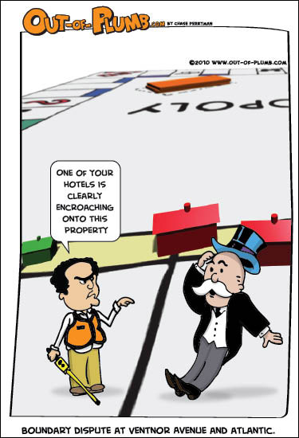
Encroachment Endorsements
Endorsement 228-06 Easement Damage or Forced Removal –
Insures against loss caused by damage to a building or enforced removal of an improvement because of an encroachment in the enumerated easement
Endorsement 228.1-06 and 228.1 Encroachments Boundaries & Easements –
Insures against loss caused by encroachments of improvements on or off the land or into easements
Improvements = existing buildings
Endorsement 228.2-06 Encroachment Boundaries and Easements, Described Improvements
Insures against loss caused by encroachments of improvements on or off the land or into easements
Improvements = what we define as improvement in the endorsement
Endorsement 228.3-06 Encroachments Boundaries & Easements Land Under Development –
Insures against loss caused by encroachments of current or future improvements on or off the land or into easements
Improvements = more broadly defined. Includes building, structure, or paved area.
We require an ALTA survey and site plans.

Slide 20
Zoning Endorsements – 203s
Minimum Standards
Location of buildings 5(D) and building locations labelled perpendicular to property lines. 6(B)(ix).
Table A Items that may be necessary
List zoning requirements supplied to the surveyor, Item 6(a), and depict setbacks, if no interpretation required by the surveyor, Item 6(b).
Dimensions, square footage, and height of buildings. Item 7(a) - (c).
Parking spaces. Item 9.
Gross land area. Item 4.

Slide 21
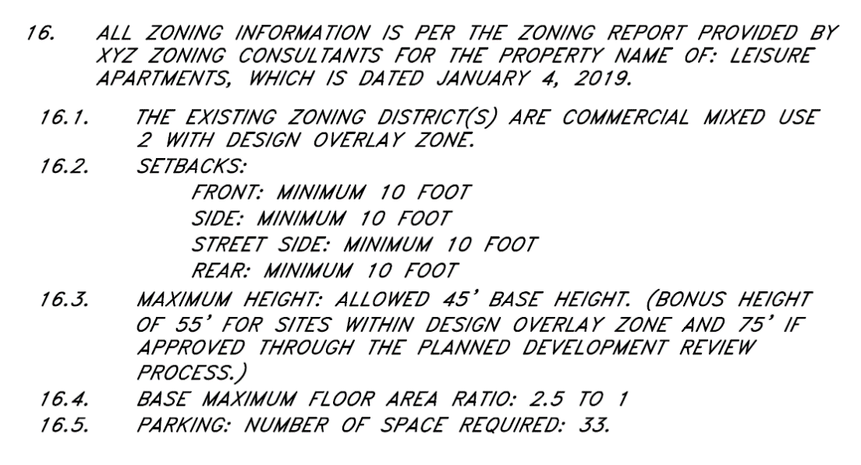
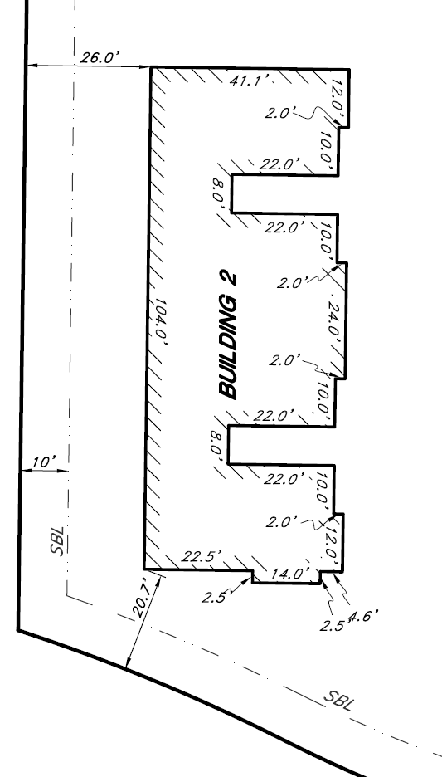
Table A – Item 6(a) & (b)
Note for 6(a)
On map for 6(b)

Slide 22
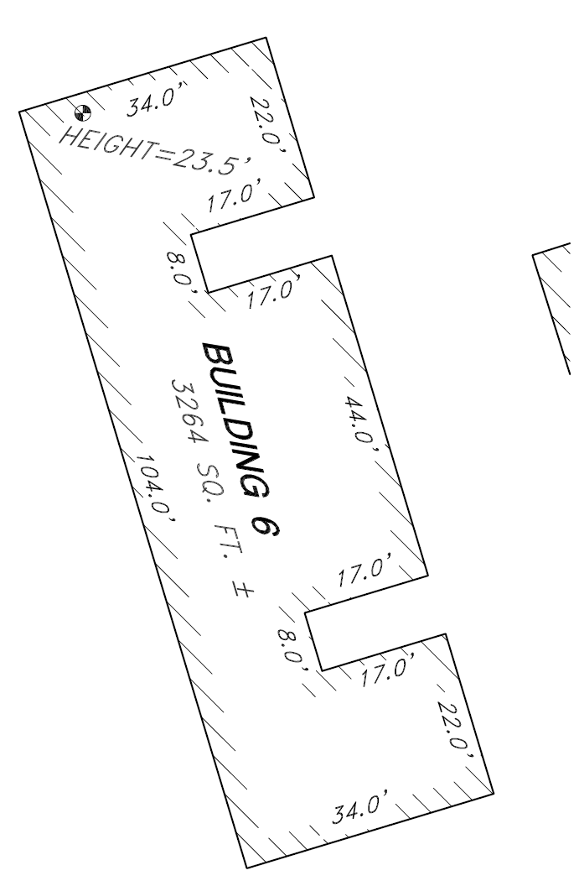
Table A - Item 7
Without Item 7(a), 7(b)(1), & 7(c)
With Item 7(a), 7(b)(1), & 7(c)

Slide 23
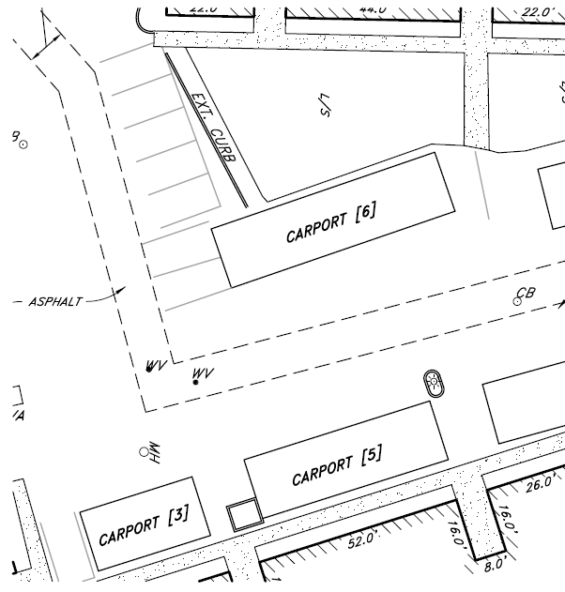
Table A - Item 9
Noted on map
Shown on map

Slide 24
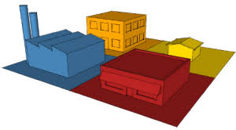
Zoning Endorsements
Endorsement 203-06 Zoning Unimproved Land and 203 Zoning –
Insures against loss caused by failing to report the correct zoning classification and allowed uses.
Typical requirements are a letter from the appropriate government authority or zoning report that
states the zoning classification for this property and
the types of uses that are permitted in under this classification

Slide 25
Zoning Endorsements
Endorsement 203.1-06 Zoning Improved Land and 203.1 Zoning Completed Structure –
Insures against loss caused by failing to report the correct zoning classification and allowed uses.
Typical requirements are a letter from the appropriate government authority or zoning report that
states the zoning classification for this property and
the types of uses that are permitted in under this classification
Additional requirements include checking that the items listed in paragraph 2 of the 203.1-06 or paragraph 3 of the 203.1 of the endorsement comply with the current zoning classification.

Slide 26
Zoning Endorsements
Endorsement 203.1-06 Paragraph 2
2. The Company further insures against loss or damage sustained by the Insured by reason of a final decree of a court of competent jurisdiction . . . requiring the removal or alteration of the structure, because, at Date of Policy, the zoning ordinances and amendments have been violated with respect to any of the following matters:
a. Area, width, or depth of the Land as a building site for the structure
b. Floor space area of the structure
c. Setback of the structure from the property lines of the Land
d. Height of the structure, or
e. Number of parking spaces.
Similar but not identical to 203.1 paragraph 3

Slide 27
Zoning Endorsements
Endorsement 203.2-06 and 203.2 Zoning Land Under Development –
Insures against loss caused by failing to report the correct zoning classification and allowed uses.
Typical requirements are a letter from the appropriate government authority or zoning report that
states the zoning classification for this property and
the types of uses that are permitted in under this classification
Additional requirements include checking that the items listed in paragraph 3 of the endorsement comply with the current zoning classification and
Checking that the items listed in paragraph 3 of the endorsement comply with the site plan for the proposed building

Slide 28
Access Endorsements
Minimum Standards
adjoining streets and access to a public rights of way. 5(B)(ii-iv).
any lack of contiguity (gaps, gores, and overlaps) between the subject property and adjoiners. 6(B)(vii).
surface evidence of utilities including utility locate markings and also utility poles within 10 ft. of boundary lines. 5(E)(iii-iv). (Sort of)
Table A Items
Appurtenant easements. Item 18.
Location of utilities on or serving the property as determined by plans or locate markings. Item 11.

Slide 29
Survey Access and Contiguity Issue

Slide 30
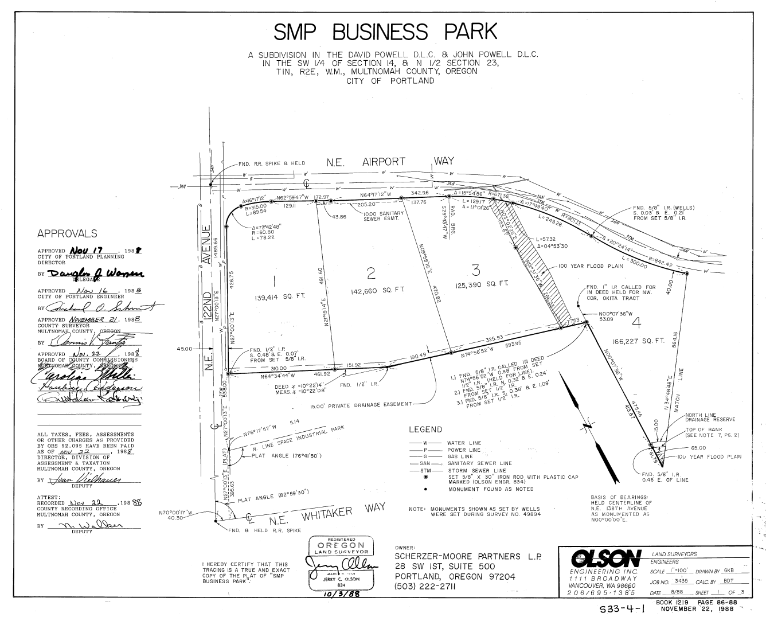
Survey Issue
Plat was done in 1988.

Slide 31
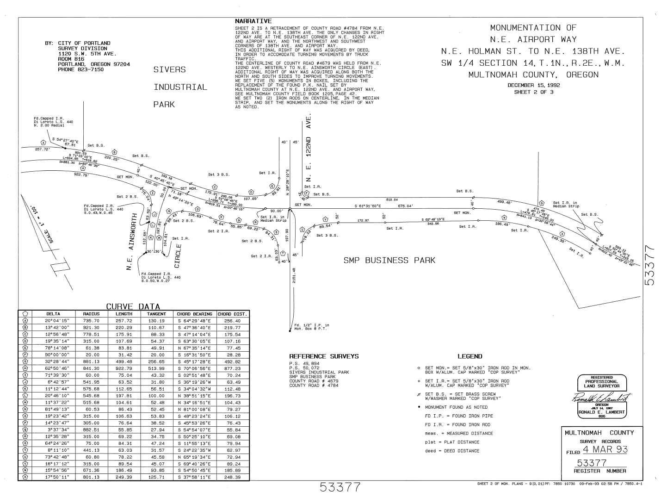
Survey Issue
City monumented the Street in 1992.

Slide 32
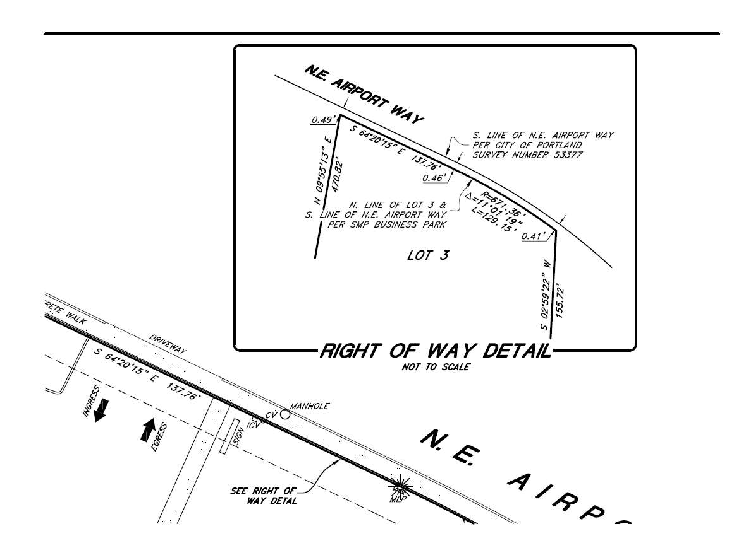
Survey Issue
Detail on ALTA/NSPS Land Title Survey.

Slide 33
Access Endorsements
Endorsement 217-06 Access and Entry –
Insures that the property abuts a publically dedicated, open road, with no obstructions or obstacles to access (cub cuts in place, no gaps).
Two elements of coverage –
Legal access from abutting a publically dedicated right of way
Physical access without obstruction
Compare to Covered Risk 4
Owner’s and Loan Policy Covered Risk 4 → Policy insures against loss or damage sustained by
“No right of access to and from the Land.” (Same for both 2006 and 2021 form policies)
Differences – I see two
Policy access does not specify source of legal access
Policy access does insure physical access

Slide 34
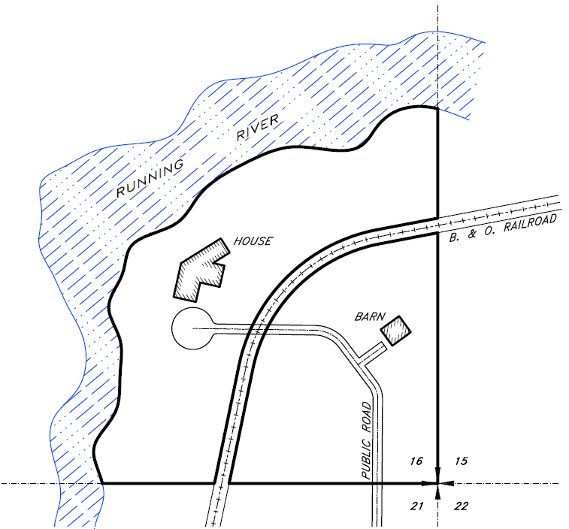
Survey Access Issue

Slide 35
Access Endorsements
Endorsement 217.1-06 Indirect Access and Entry–
Insures that an appurtenant access easement commences on a publically dedicated, open road, and terminates on the boundary of the insured property, with no obstructions or obstacles to access (curb cuts in place, no gaps – consult survey).
The form of this endorsement requires that the appurtenant easement be a separate parcel.
Often require an ALTA Survey that includes the appurtenant easement.

Slide 36
Access Endorsements
Endorsement 217.2-06 Utility Access
Insures that specified utility types have legal access to the property
Often require an affidavit by the seller that specific utilities serve the property
May also require an ALTA survey to show no gaps, gores, or overlaps between the subject property and adjoining properties or streets and depicting utility lines that service the property.

Slide 37
Contiguity Endorsements – three types
Minimum Survey Standard
any lack of contiguity (gaps, gores, and overlaps) between the subject property and adjoiners. 6(B)(vii).
Endorsement 219-06 Contiguity Multiple Parcels –
Insures that that all of the parcels in the policy about each other in some combination without gaps or overlaps.
Endorsement 219.1-06 Contiguity Single Parcel –
Insures that the property abuts its neighbors on all sides without gaps or overlaps.
Endorsement 219.2-06 Contiguity Specified Parcels –
Insures that there are not gaps, gores, or overlaps between the specified parcels.

Slide 38
Same as Survey Endorsements
Minimum Survey Standard
boundary lines with labeled courses, point of beginning and point of commencement if applicable. 6(A), (B)(iii).
Endorsement 225-06 Same as Survey –
Insures that the survey depiction and the policy description describe the same property
Endorsement 225.1-06 – Same as Portion of Survey Endorsement –
Insures that the survey depiction and the policy description describe the same property for the specified parcels

Slide 39
Thank you!!
Questions?
Feel free to call with additional questions:
Justin Carter, Underwriting Counsel,
Chicago Title Insurance Company,
justin.carter@ctt.com, 503-250-4554
Brady McGarry, Professional Land Surveyor,
Chase Jones & Associates,
brady@chasejonesinc.com, 503-228-9844

