Slide 1
Easements and Title to Vacated Roads
By Justin Carter,
Associate Underwriting Counsel
Chicago Title Insurance Company
And Ticor Title Company

Slide 2
Easements
Easement in gross vs. easement appurtenant
Unwritten easements
Prescriptive easement
Implied easement
Easement by Necessity
Express easements
Creation and termination including the Partney decision

Slide 3
EASEMENTS
What is an easement?
An easement is a nonpossessory interest in the land of another that entitles the owner of the interest to a limited use or enjoyment of the other’s land and to protection from interference with this use.
The inter­est, once created, may be irrevocable and generally is not subject to the will of the landowner.
Bundle of sticks – all of the interests in a property
Single stick – an easement interest held by an easement holder

Slide 4
Appurtenant vs. in gross
APPURTENANT – THE EASEMENT IS GIVEN FOR THE BENEFIT OF ANOTHER PROPERTY.
DOMINANT ESTATE – BENEFITED PROPERTY
SERVIANT ESTATE – BURDENED PROPERTY
CARRIED IN CHAIN OF TITLE – ONCE GRANTED DOES NOT NEED TO APPEAR IN SUCCEEDING DEEDS
In gross – easement is unrelated to the easement holder’s possession or ownership of land. Example – utility lines
Transferability
Personal – non-transferable
Commercial – transferable
Test – is the easement a natural adjunct of the use of the land (appurtenant) or is it personal in nature (In Gross)?
With a presumption of appurtenant

Slide 5
Prescriptive easement
Requirements – essentially the same as adverse possession
acquirer's use of another’s land must be:
Continuous – 10 year period in Oregon
Open and Notorious – owner knows or should know of use
Actual – Use must be of the nature of an easement holder
Hostile – without owner’s permission

Slide 6
Implied Easement
AKA easement by prior use
An easement legally implied based on prior use by a common grantor on land subsequently divided into multiple lots
Requirements –
Easement exists prior to division of a single tract
Common grantor’s use is continuous and apparent
Use is reasonably necessary for enjoyment of the dominant estate
Parties intended the use to continue after division
Disfavored in Oregon. Oregon has adopted a multi-factor test that gets at intent of the former common owner and equity of granting the easement

Slide 7
Easement by necessity
An easement can arise if access to or from a property is impossible without the easement (ei. the easement’s existence becomes necessary)
Creation – arises when a landowner sells a portion of her property, and the resulting division deprives one lot owner of access to a public road or utility
Court will determine a reasonable location

Slide 8
Creation of an Express easement
Requirements -- generally Same requirements as deed
Writing (statute of frauds)
Reservation, together with, or separate document
Grantor and grantee
Signed by grantor (the owner of the servient estate)
lawfully executed and delivered
Conveyance language – some affirmative language granting the easement
Specific Purpose
Describes the land encumbered by the easement (servient estate)
Title insurance – If there is no definitive description, an exception for lack of definitive location may be applicable
Best practices
Recorded (succeeding servient estate holders must have notice of the easement to be bound)
Requires notarization
Describes dominant estate if appurtenant easement

Slide 9
termination easement
Expiration by own terms – time period or condition
Conveyance from dominant estate releasing interest
Prescription – this is the flip of acquiring an easement by prescription in that the servient estate becomes the adverse party. The servient owner’s use must be clearly wrongful and actionable against the easement holder.
Merger – easement terminates with unity of title of the dominant and servient estates

Slide 10
Partney vs. Russell 304 Or App 679 (2020)
Facts – convoluted, but essentially suit to enforce an express easement where the grantor and grantee were the same party.
Holding – The Court finds the easement unenforceable based on the doctrine of merger

Slide 11
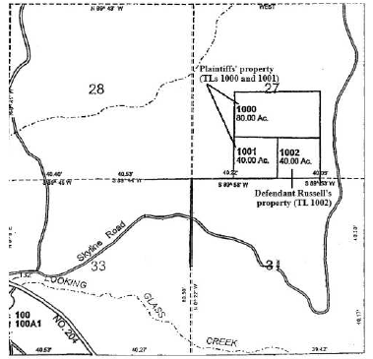
Partney’s owned tax lots 1000 and 1001
Russell’s owned tax lot 1002
P had sued R over use an easement
P had lost at trial court and appealed
Haneys are P’s and R’s predecessor in title
H acquired title to TLs 1000, 1001, 1002 (through entity called Seven Springs Development Corp.)
H signed a Declaration of Easement granting an appurtenant easement to all three properties for access to Skyline Road over all three properties

Slide 12
H sign deed from Seven Springs to themselves TL 1001 and 1002
“Together with easement for ingress and egress to Skyline to be used in common over . . . [1000, 1001, and 1002]”
H sells 1001 and 1002 to separate buyers together with an easement to access Skyline over the other Lot (1001 or 1002)
The deed for 1002 subject to easements of record
subsequent deeds have a subject to lists of documents that include the declaration
When P acquired the property, the deed included --
Parcel 2 for “Easement for ingress and egress . . . Contained under [the Declaration]” and
Subject to “roads and easements . . . Described under [the declaration]”

Slide 13
Partney vs. Russell 304 Or App 679 (2020)
Issue – Did the declaration create an enforceable easement over tax lot 1001 for the benefit of 1002?
Holding – No, a declaration of easement when the declarant holds title to both the dominant and servient estates does not create a valid easement
Explanation
Basically, outside of platting, an owner cannot create in easement in her own property. Witt v. Reavis, 284 Or. 503 (1978).
Even when platting the easement is technically not formed until the plat declarant conveys the property
by definition, an easement is an interest in the land of another. Thus, any easement created by the declaration was essentially extinguished at inception.
Once extinguished, an easement cannot be revived by mere reference to the easement in subsequent instruments
A subsequent “subject to” list including the “merged” easement does not create the easement
However, a valid easement can be created if the extinguished easement is later incorporated by reference in a granting or reserving clause in a subsequent deed
Here, no such incorporation was made when the deed grantor owned lot 1001 and conveyed lot 1002
Inference from circumstances – “the intent to convey a lot or unit subject to a declaration may also be inferred from the circumstances.” (Unclear exactly what the court means but I believe it’s referencing a common development scheme)
H convey to themselves out of seven springs less than a week after signing the declaration, then convey to a buyer for 1002 subject to the easement, and record all these documents on the same day
Still, the declaration itself did not create the easement and h had unity of title when they acquired from seven springs. So, even if intent could be inferred in the conveyance from seven springs, merger would have extinguished.

Slide 14
Odd Oregon Exception to Merger rule
A landowner can create an easement that benefits and burdens her own property through an easement to another party that reserves a right to future use. Ploplys v. Bryson, 188 Or App 49 (2003).
The document that creates the easement must consider future partitioning of the property and expressly make the easement appurtenant to properties owned by each party. Fischer v. Walker, 246 Or App 589 (2011).

Slide 15
Odd exception continued
Ploplys Facts
P and D common predecessor granted an easement to third party
Easement
reserved the right to use road
Provided easement appurtenant to properties owned by each party
In the event of subdivision, easement shall remain appurtenant
Grantor later partitioned creating the properties of P and D and deeds “referenced” the easement
P used the road, D blocked, P sued
The Court held that the predecessor reserved an easement for the benefit of his property and that reservation created a new right in the grantor’s property out of the easement interest that was granted

Slide 16
Odd exception continued
Fischer Facts
Similar to Ploplys except the easement from the predecessor
lacked language about future subdivision,
did not create an appurtenant easement for future parties, and
was not referenced in future deeds
The court held that these three items were necessary for creating a Ploplys easement

Slide 17
Vacation and Dedication
Vacation applies to lands acquired through dedication
Not to lands acquired through purchase or eminent domain
Lands acquired through purchase or eminent domain are typically held in fee and conveyance of property is required to clear interest of the state, county, or municipality
Example of Land Acquired through Eminent Domain

Slide 18
Example - Chain of Title
ODOT condemnation suits acquire title to various strips through eminent domain
ODOT conveys portions back into private ownership and portions to Washington County
ODOT deed to Washington County “only so long as used for public road purposes”
Washington County vacation portions of road
Meanwhile – multiple deeds in private ownership include the remaining strip of property
Problem – Washington County retained fee title subject to a reversionary interest of ODOT
Resolution – Deeds from both Washington County and ODOT

Slide 19
Disposition of Dedicated Lands
Dedication – a relinquishment of land to a public use made by the landowner and accepted for such use by or on behalf of the public. Harris v. City of St. Helens, 72 Or 377, 386, 143 P 941 (1914)
The dedicator retains the fee subject to the public’s right of use, which is in effect only an easement. See Haberly v. Treadgold, 67 Or 425, 136 P 334 (1913) (the city cannot sell property dedicated to the public for a street).
Provisions for street dedication are found in ORS Ch. 92 for plats of subdivision and partition and in Ch. 368 for county roads.
Dedication of land to use as a public street requires local government approval, ORS 92.014.
Dedication may be by plat of subdivision or partition, or by separate dedication or donation form provided by the city or county with jurisdiction, ORS 92.175 and ORS 368.096.

Slide 20
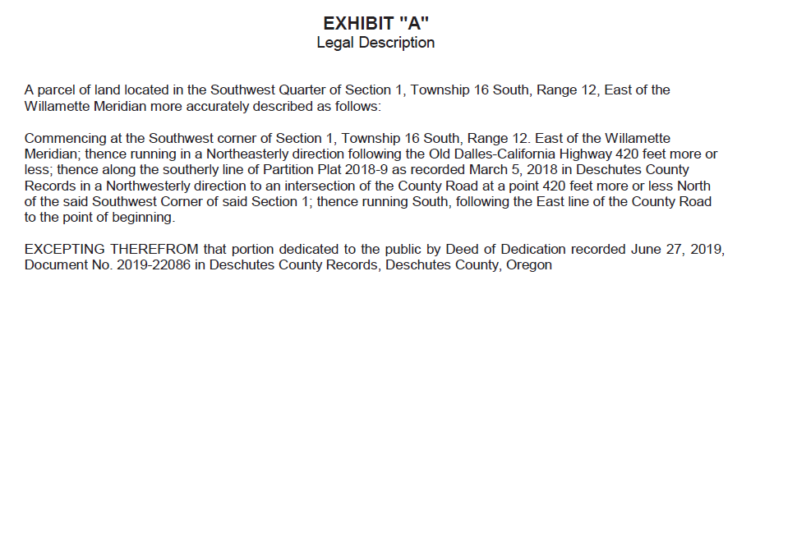
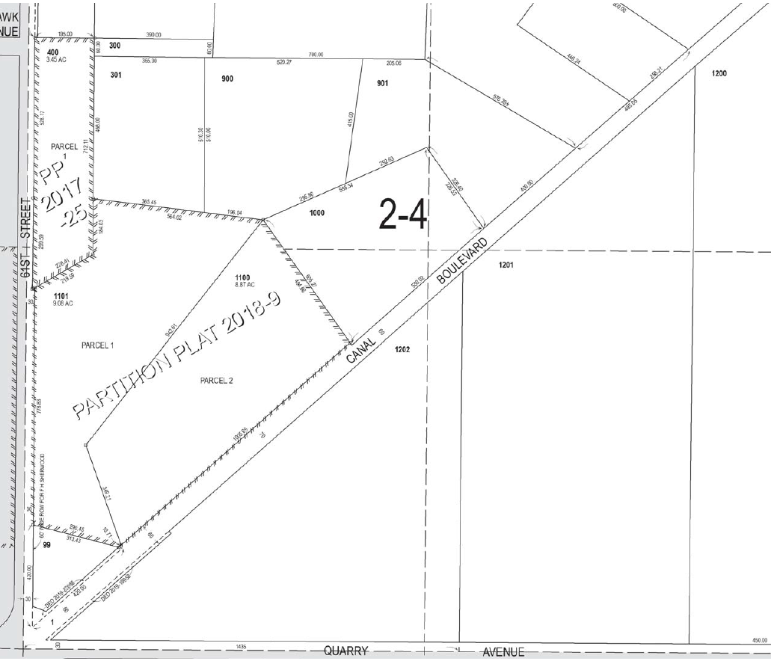
Disposition of Dedicated Lands Depiction on Title Report
Or as an exception – Public Road Dedication including the Terms and provisions thereof, recorded 6/27/2019 as instrument no. 2019-22086.
Or a generic exception – Rights of the public in that portion located in Public Roads and highways.

Slide 21
Vacation
The public merely has an easement or right-of-way over a public way.
When this right-of-way is terminated by vacation, the fee title, which is deemed to have remained in the abutters (through the dedicator), is simply discharged from the servitude. See Fowler v. Gehrke, 166 Or 239, 241 (1941).
The street attaches to the abutting property on each side, in equal proportions; the dividing line is the center line of the public way. ORS 271.140 (city vacations), ORS 368.366(1)(d) (county vacations); Fowler, 116 Or at 241.
If the entire width of vacated street was dedicated out of a single parcel, then the vacated premises attaches to the original parcel. ORS 271.140 (codification of common law rule)
Most often the case where dedicated road was on the margin of a plat. See Example.

Slide 22
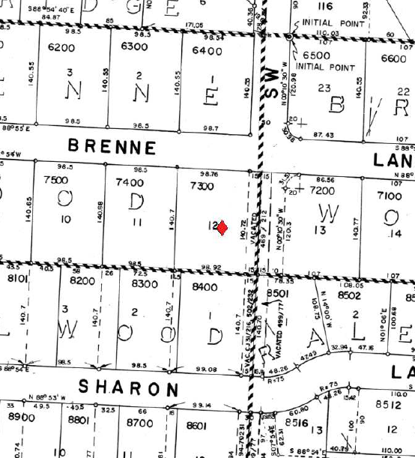
Example – Entire Width Attaches to Parcel

Slide 23
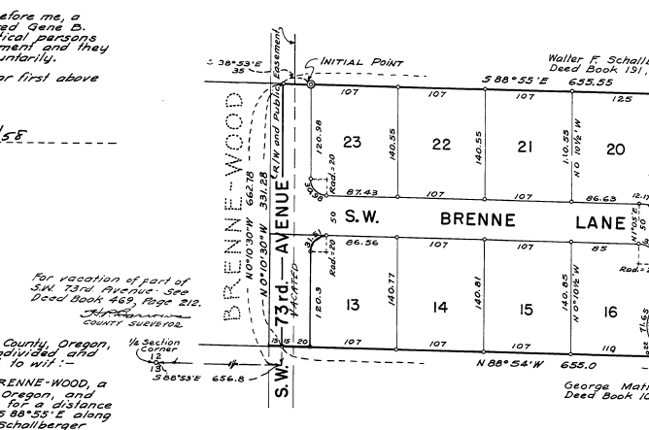
Example – Entire Width Attaches to Parcel
Plat - Brenne-Wood
Plat - Brenne-Wood 2

Slide 24
Exception
If both sides of the street were in the same ownership at the time of the dedication, then the street attaches to the abutting owner on each side in equal proportions. Howe vs. Greenleaf, 260 Or.App. 696, 320 P.3d 641, (2014).
Howe vs. Greenleaf
Facts – P sued D alleging ownership to the centerline of a vacated road. P and D common predecessor in title owned 36 acres, subdivided a portion, and dedicated roads on the plat. The road in question was on the margin of the plat adjacent to D’s property.
holds that when a two adjacent properties are in the same ownership and a road is dedicated on the margin of one of those two properties, if the road is later vacated then former right of way goes 50-50 to the adjacent properties unless there is clear intent in the chain of title that the adjacent property that did not dedicate the road excludes the road. In this case, legal descriptions for the adjacent property ran to the road as a boundary. To the court, this was not sufficient to expressly exclude the road. So, once vacated, the road went 50-50 to both property owners.

Slide 25
Summary of Rules
General rule for fee title after street vacation – The street attaches to the abutting owners on each side in equal proportions.
Exception – When the abutting street was originally dedicated out of one parcel, then the vacated street attaches entirely to the abutting parcel that it was dedicated out of.
(Most typical occurrence when the street as on the margin on a plat.)
Exception to the Exception – Even if the property came entirely out of one parcel, if both sides of the street were in the same ownership at the time of the dedication, then the street attaches to the abutting owner on each side in equal proportions,
Unless there is clear intent in the chain of title that the adjacent property that did not dedicate the road excludes the road.

Slide 26
Example – Entire Width Attaches to Parcel???
Plat - Brenne-Wood
Plat - Brenne-Wood 2

Slide 27
Example – Entire Width Attaches to Parcel???
Plat - Brenne-Wood
Plat - Brenne-Wood 2
Dedicators – George Grace, Esther Grace, Howard Brenne, Barbara Brenne, Albert Call, and Eudora Call – Singed in 1954
Dedicators – Gene Talbott and Brownibal Talbott
Signed in 1955
The exception to the exception likely would not apply. First, 73rd Ave was not a dedication (in this area) entirely out of one plat. 73rd was dedicated from both Brenne-Wood and Brenne-Wood 2 at different times. Second, Brenne-Wood and Brenne-Wood 2 were not in common ownership at the time of the dedication. The width of 73rd is comprised of two separate vacated strips – separate plats, different dates, separate ownership – inuring to opposite sides of the street. Therefore, the vacated 15 ft. portion of 73rd Ave that was dedicated through Brenne-Wood would inure to Lot 12.

Slide 28
Vacated property inures to adjoining owner
Does a vacated street pass with the adjoining property even if subsequent deeds fail to convey the vacated street or is title to the vacated property left with the adjoiner at the time of vacation?
That problem was resolved by Fahey v. City of Bend, 252 Or 267, 270 (1969) (after conveying property without reference to the adjoining portion of the vacated street, city purported to convey the portion of the vacated street to another party), which held that the portion in the vacated street will pass in the absence of any manifestation of a contrary intent.
Rule – absent contrary intent, a deed conveys vacated property that inures to an adjoiner even if the deed makes no reference to the vacated property.

Slide 29
Title Issue
Conveyance of vacated road separate from adjoining property
Vacation Ordinance
Executed November 19, 2019
Recorded November 27, 2019
Passed by Portland City Council September 16, 2020
Recorded November 10, 2020
Issue – Does the quitclaim deed convey the vacated property?
Rule – The portion in the vacated street will pass with the adjoining property in the absence of any manifestation of a contrary intent.
Conclusion – The quitclaim deed would certainly be a manifestation of contrary intent. However, we are not sure whether the rule even applies to intent in the deed made before the vacation. Moreover, this deed is a quitclaim deed, which does not carry after acquired title. At the time the deed was signed, the grantor did not have title to the vacated road. The grantor had title to the dedicated roadway subject to the public easement. This scenario is a legal uncertainly. Lawyers and title companies alike don’t like uncertainty.

Slide 30
Vacation and Public Utilities
Vacation orders frequently reserve easements for public utilities.
Title Company – will usually take exception to any public utilities located in the vacated road even if the vacation order lacks a reservation for public utilities.
Why? Easements via prescription. Public utilities might run through the vacated road even if the vacation order fails to address utilities.
Clearing the exception (ask you underwriter) –
Reservation in the Ordinance – Quitclaim deed from public utility companies – gas, water, sewer, power – terminating any right that they may have retained.
No reservation in the Ordinance – Letters from public utility companies stating that the company has no utility in the vacated road are typically sufficient to remove the exception.
Often buyers don’t care to clear the exception unless they are planning on building on the property.

Slide 31
Vacation and Public Utilities
Building built over the top of a vacated road
Eventually cleared through letters from public utility companies

Slide 32
CONCLUSION
Conclusion –
Easements
Express or judicially created
Express – appurtenant vs. in gross, creation, termination
Partney
Vacation
Inapplicable to roads held in fee
Dedicated lands are easements for public use over retained fee
Vacation removes public easement
Who gets title? 50-50 unless all out of one parcel, unless dedicator owned both sides of road
Vacated roads inure to abutting property even if no “together with” in subsequent deeds
Vacated roads may be subject to public utilities
Questions?
Contact Info
Justin.carter@ctt.com
503-973-7406

