Slide 1
All things Construction Lien and Early Issue
Justin Carter, Associate Underwriting Counsel, Chicago and Ticor Title
John LaVeille, Underwriter, Legal Counsel, Chicago Ticor Title

Slide 2
Roadmap
What is a construction lien?
Who is entitled to a lien?
Perfection of liens and foreclosure suit
Completion of Construction
Bonding of a Construction Lien
Priority Issues Affecting Title Insurance
Home Buyer’s Protection Act
Early Issue
The OTIRO 232-233 endorsements

Slide 3
What is a construction lien?
Construction liens (known as mechanic’s liens in other jurisdictions) are a super remedy granted by statute
Super remedy – Without special statutory treatment, a claimant would have to sue and establish a judgment against the party in contract with them, obtain a judgment, and then enforce this judgment
Claim of partial interest in property – specifically in the improvement that labor or materials were provided for

Slide 4
What is a construction lien?
Public policy -
Provides a remedy to subcontractors and suppliers who do not have a contract with the owner of the property
Recognizes that constructed improvements provide an immediate benefit to the property owner
Encourages development
Notes:
(1) Quasi contract or other more difficult means of establishing a claim
(2) Unjust enrichment

Slide 5
Who is entitled to a lien?
For title insurance – main concerns are contractor, all subs, suppliers, engineers, architects, and surveyors

Slide 6
Perfection of Liens
Prerequisites
Contractor must be licensed at the time of signing the contract and throughout performance of work. ORS 701.131. (There are some limited exceptions)
Notices – ORS Chapter 87 requires a variety of notices. Generally, a potential lien claimant must provide notice before recording a claim of construction-lien. Notices required vary depending on the relationship with the property owner whether the project is for residential or commercial use.

Slide 7
Perfection of Liens
Recording a Notice of Claim of Lien
When? Must record within 75 days after the earlier of either –
The lien claimant ceasing to provide labor, equipment, or materials or
Construction completed. ORS 87.035(1)
Completion
For individual claimant
A person has “ceased to provide” labor or materials when the contract is substantially complete. Substantial completion occurs when a contract is essentially complete but for repair of contractor’s own substandard work or so-called trifling matters.
Akin to substantial performance- in contract law, which means that a party has performed all material elements of the contract but there are non-material elements left to perform.
For project
Completion of construction occurs when (1) the improvement is substantially complete, (2) completion notice is posted and recorded, or (3) the improvement is abandoned.
Notes:
Illustration – Choose something fairly early in the construction process like framing. The framer would have 75 days from the day he or she completed work to claim a lien. After those 75 days elapse, the framer could not make a valid claim of lien even though the project may not be completed for say another 8 months.

Slide 8
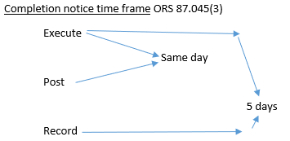
Perfection of Liens
Completion (project) ORS 87.035(1)
(1) the improvement is substantially complete – all contracts are substantially complete
Certificate of Occupancy is often strong evidence of substantial completion
(2) completion notice is posted and recorded
Who may record? Owner, mortgagee, or contractor
Contents – substantially in the form of ORS 87.045(2)
Timing –
Restart of the 75-day claim of lien period – An owner or mortgagee cannot post and record a completion notice and later argue that substantial completion has already occurred. Star Rentals, Inc. v. Seeberg Constr. Co., Inc., 66 Or App 822, 829 (1984)
(3) the improvement is abandoned – either 75 after work ceases or when a notice of abandonment is recorded.
Notes:
Certificate of occupancy means the county or city has certified that the building is safe to occupy, which generally coincides with the work being substantially complete.
Must be posted in a conspicuous location on the property.

Slide 9
Perfection of Liens
Recording a Notice of Claim of Lien
Where? In the county where the improvements are located. ORS 87.050.
Contents – the claim must contain
Statement of demand,
Name of the owner, or reputed owner,
Name of the person who hired the contractor, and
Description of the property including address, if address known. ORS 87.035

Slide 10
Foreclosure of Lien
Required notices
Notice of lien – lien claimant must mail to owner and mortgagee a “notice that the claim has been filed” (recorded) within 20 days of filing. ORS 87.039(1).
Notice of Intent to Foreclose – lien claimant must mail to owner and mortgagee a notice of intent to foreclose the lien within 10 days of commencing the foreclosure suit. ORS 87.0578(1).
Foreclosure suit – complaint must be filed within 120 days of the date the lien was recorded. ORS 87.055.

Slide 11
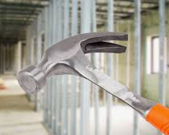
87.030 – Leaseholds and Notice of Non-responsibility
If the lessee contracts to construct improvements with the owner’s knowledge, a lien attaches to the owner’s interest (underlying fee)
Unless a notice of non-responsibility is posted
Notice of non-responsibility
Must be posted in some conspicuous place upon the land or the improvement
Within three days of learning about the construction work

Slide 12
Bonding Lien
Bonding or depositing funds with county treasurer – collectively known as “bonding”
Procedure set out in ORS 87.076 to 87.083 to remove the lien from the property.
Two step process
Step 1 – A property owner may bond a construction lien against her property by
(1) depositing money with the county treasurer or
(2) purchasing a bond from a bonding company and recording the executed bond. ORS 87.076.
The deposited or purchased amount must be for 150% of the construction lien.
Step 2 – To have the lien lifted from the real property, the owner must then
(1) notify the lien claimant of bonding
a. within 20 days of the deposit or purchase
b. including the location and time of the deposit or purchase, ORS 87.078(1), and
(2) record an affidavit stating that the lien claimant has been notified, ORS 87.081(1).
Effect – the lien is lifted from the real property and attached to the bond or deposit. ORS 87.083(1).

Slide 13
Priority Issues
For title insurance, priority of a construction presents two issues
(1) Relation back – “The perfection of a lien under ORS 87.035 relates to the date of commencement of the improvement as defined in ORS 87.005.” ORS 87.025(7).
“‘Commencement of the improvement’ means the first actual preparation or construction upon the site or the first delivery to the site of materials of such substantial character as to notify interested persons that preparation or construction upon the site has begun or is about to begin.” ORS 87.005(1).
Effect – if work was done in the 75 days prior to closing, then a recorded claim of construction lien would relate back to commencement and take priority ahead of either the deed or mortgage that we insure in that closing. (Inchoate lien.)
(2) Loan funds alteration or repair – “Unless the mortgage or trust deed is given to secure a loan made to finance the alteration or repair, a lien created under ORS 87.010 and perfected under ORS 87.035 for the alteration and repair of an improvement commenced and made subsequent to the date of record of a duly executed and recorded mortgage or trust deed on that improvement or on the site shall not take precedence over the mortgage or trust deed.” 87.025(6)
Effect-if any amount of loan proceeds funds improvements on the property, the priority of that deed of trust is primed by a perfected construction lien.
Notes:
Inchoate – something that is about to come into existence

Slide 14
Home Buyer’s Protection Act
Codified in ORS 87.007
Applies to
Generally, to new residential construction and
to residential property where $50,000 in remodeling or renovation have been completed within 90 days of a sale. See 87.007(1)(a), (b), and (c) (subsection (c) applies to residential buildings with “not more than four dwelling units . . . .”).
Obligation of seller (not the title and escrow company). See ORS 87.007(2).
87.007(2), requires the seller to provide one of the following (again generally):
(a) title insurance coverage against construction liens from the project
(b) an escrow deposit of at least 25% of the sale price to pay for potential construction liens
(c) a bond or letter of credit of at least 25% of the sale price to pay for potential construction liens
(d) unconditional lien waivers from all subs and suppliers or
(e) closing after the 75-day claim of lien period has elapsed

Slide 15
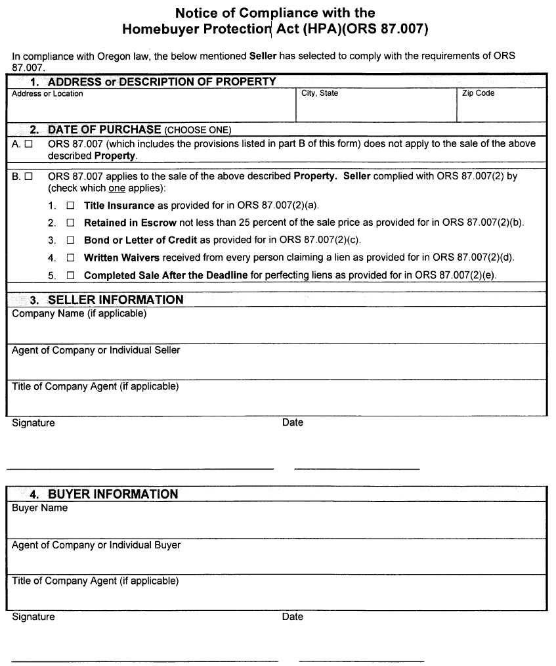
Home Buyer’s Protection Act
The Contractor’s Construction Board has promulgated a notice form for compliance with ORS 87.004

Slide 16
What is early issue?
Providing coverage without general exception 5 while there is construction lien risk.
General Exception 5 – Any lien or right to a lien for services, labor, material, equipment rental or workers compensation heretofore or hereafter furnished, imposed by law and not shown by the public records.
Construction lien risk? Two scenarios –
When work has been done in the 75 days prior to closing,
When a construction work is ongoing, or
When a portion of loan proceeds will finance construction
OTIRO Rating Manual 5.002, New Construction, defines construction as the following:
A. “Construction” for purposes of this Section means pending or completed improvements to real property for which claims of construction lien may exist or arise, whether through new improvements or the alteration, expansion, renovation, remodeling or rehabilitation of existing improvements.

Slide 17
Early Issue Charges
Generally, charge for removing exception + charge for early issue risk
Removing exception under 5.001(A)(5).
25% BIR to $5m liability amount
20% BIR for amounts beyond $5m
“The charge required under Section 5.002 shall be assessed in addition to the charge under this subsection except when the owner’s policy is issued with a simultaneous Loan Policy without Standard Coverage Exception No. 5, in which event the Company, in its discretion, may eliminate the exception in the owner’s policy at no additional charge . . . .”

Slide 18
Early Issue Charges
Charging for Early Issue under 5.002(B)
After completion of construction but before expiration of the statutory lien period
Charge $1/$1,000 of liability amount to $100,000
Charge $2/$1,000 of liability amount beyond $100,000
Must obtain satisfactory evidence that liens will not be filed and satisfactory indemnity
Subsection (F), evidence that construction liens will not be filed consists of one or more of the following –
Lien waivers,
Inspection of premises,
Inquiries of occupants and neighbors,
Inquiries of subcontractors and suppliers, review of construction disbursement program,
Determination of financial strength and reputation of mortgagor or contractor,
Performance or completion bond,
Cash deposit,
Letter of credit or other security for an indemnity,
Other reasonable provision for payment of those entitled to assert construction liens

Slide 19
Early Issue Charges
Charging for Early Issue Under 5.002(C)
Before completion of construction
$2.50/$1,000 for liability amount
Must obtain satisfactory evidence that liens will not be filed and satisfactory indemnity
Subsection (F) covers what constitutes satisfactory evidence that liens will not be filed
Typically, getting satisfactory evidence that liens will not be filed is not possible for a closing before completion

Slide 20
Early Issue Charges
Exceptions to the charges outlined in Subsections (B) and (C)
Subsection (E) – Applies when a portion of loan proceeds finances improvements on commercial property (not 1-4 family residential), but the primary purpose of the loan is not construction
The early issue charge under Subsection (B) or (C) applies, but is based on the actual or projected cost of construction
Subsection (E) -- The early issue charge may be waived based on a notice of non-responsibility.
Subsection (H) – Applies when a portion of loan proceeds finances improvement on 1-4 family residential property, but the primary purpose of the loan is not construction.
The early issue charge under Subsection (B) or (C) may be waived, unless the property is a newly completed dwelling
Subsection (G) – Exception under 5.001(A)(5) applies. When owner’s policy is issued with simultaneous lender’s policy without exception 5, the early issue charge can be waived at the title company’s discretion
Subsection (D) – If the OTIRO 232 and 233 Endorsements are going to be issued, the charge for the endorsements replaces the early issue charge

Slide 21
Oregon Typical Early Issue Protocol
Oregon Construction Lien Law – 2 scenarios give rise to construction lien risk
Work completed within 75 days prior to closing
Construction loan
Construction Loan Title Policy
Dirty Policy Issued = Construction Lien Exception
OTIRO 70 Endorsements with each draw
Provides there are no recorded construction liens except those listed in policy and on the endorsement
OTIRO 66 Removal of Exception issued after 75-day claim of lien period expired

Slide 22
Limited Construction Lien Coverage for Loan Draws
One endorsement from the 232 series is issued in conjunction with endorsement 233 on each draw.
Modification of Construction Lien Exception –
Any statutory lien or claim of lien, affecting the Title, that arises from services provided, labor performed, or materials or equipment furnished, except as insured by the attached ALTA [32-06, 32.1- 06 or 32.2-06] (OTIRO [232-06, 232.1 it may be revised by ALTA 33-06 (OTIRO 233-06) Endorsements.
Endorsement 232 Series – Modifies the construction lien exception in the policy to insure to the extent that coverage is provided under Endorsements 232 and 233.
Endorsement 233 – A datedown endorsement that provides incremental coverage for each construction loan disbursement.

Slide 23
Limited Construction Lien Coverage Continued
The 232-06 provides construction lien coverage for claims from sub-contractors and suppliers.
The 232.1-06 and 232.2-06 provide coverage for claims from the general contractor, not sub-contractors and suppliers.
The 232.1-06 requires disbursements be made through the issuing title insurance company.
232.2-06 requires disbursements be made through the lender.
These endorsements require extensive time and information to underwrite. The required information typically includes:
Indemnity and Financials from the builder
Lien waivers or confirmation payments from subs-contractors and suppliers
Cost: $1 per $1,000 of the loan amount.

Slide 24
Questions
Justin.carter@ctt.com
John.laveille@ctt.com

