Slide 1
Oregon Land Title Association
Educational Seminar
November 9, 2023
2023 Legislation and Case Law Update
Ian Kyle, Fidelity National Title Group

Slide 2
Part I:
Case law update.

Slide 3
Case #1:
Freeborn v. Dow, 322 Or. App. 695 (2022)
The deed is done, but is it a done deal?

Slide 4
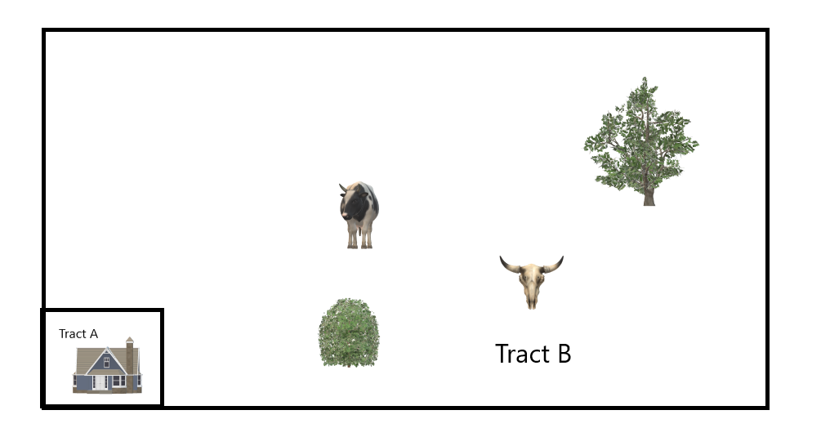
Case #1:
Freeborn v. Dow, 322 Or. App. 695 (2022)
Facts
  In 2013 plaintiffs, Freeborns, sold two tracts of land to defendant, Dow.
    Tract A, a 5.65-acre residential homestead, and
    Tract B, a 119.8-acre pasture:
  However, Tracts A and B were not actually separate legal lots.

Slide 5
Case #1:
Freeborn v. Dow, 322 Or. App. 695 (2022)
Sidebar: What is a legal lot?
  ORS 92.010(3)(a) defines a ‘lawfully established unit of land’ as one that is:
    (A) Created by subdivision, partition, or PLA under ORS Chapter 92 (enacted 1973), or
    (B) Created in compliance with ‘all applicable planning, zoning, and subdivision or partition ordinances or regulations’, or
    (C) By deed or land sales contract
      (if there were no such ordinances or regulations at the time of creation.)
    Finally, tax lot does not mean legal lot. ORS 92.010(3)(b).
  Risks to buyer:
    May not be able to obtain building permits or resell property without disclosure. Remedies against seller.
  Title insurance coverage in Oregon?

Slide 6
Case #1:
Freeborn v. Dow, 322 Or. App. 695 (2022)
Facts, cont.’d
  A deal was struck:
    $400,000.00 total sale price
    Plaintiffs would convey both Tracts A and B to Defendant at closing.
    Plaintiffs would retain possession of the residential Tract, Tract A, while they pursued partition of Tracts A and B into separate legal lots at their expense.
    Defendant would convey title to Tract A back to Plaintiffs after the partition approved.

Slide 7
Case #1:
Freeborn v. Dow, 322 Or. App. 695 (2022)
Facts, cont.’d
  Specifically, the sale agreement provided that Plaintiffs would pursue the partition and that:
    “After the closing … Purchaser shall be entitled to exclusive use and occupancy of the pasture parcel and Seller shall be entitled to the exclusive use and occupancy of the homestead parcel. Upon completion of the partition, Purchaser shall convey homestead [back to] Seller for no further consideration.”
    Quoted in 322 Or. App. 695 at 698.

Slide 8
Case #1:
Freeborn v. Dow, 322 Or. App. 695 (2022)
Pause in the action:
Deed #1:
  Freeborn to Dow
  Warranty Deed for Tracts A and B
  No reserved right to occupy homestead by Freeborn appeared on face of deed.

Slide 9
Case #1:
Freeborn v. Dow, 322 Or. App. 695 (2022)
Meanwhile, back at the ranch:
  Plaintiffs (Seller) pursued partition from 2013-2017
    Never completed.
    It may have been impossible to complete, as we will see later.
  Boldly forging ahead anyway, Buyer Dow listed the pasture tract for sale in 2017
  A third party, Jefferson Equities, then closed on both Tract A and Tract B in 2018
    And served eviction notice on Freeborns to quit the homestead, prompting the litigation

Slide 10
Case #1:
Freeborn v. Dow, 322 Or. App. 695 (2022)
Deed #2:
  Dow to third-party buyer Jefferson Equities
  Warranty Deed for Tracts A and B
  No reservation of occupancy by Freeborns
Two warranty deeds have recorded with no reference to the Freeborns’ right to occupy the homestead indefinitely until partition completed.

Slide 11
Case #1:
Freeborn v. Dow, 322 Or. App. 695 (2022)
Litigation
  Freeborn sued Dow, alleging breach of contract and elder abuse
    No quiet title claim mentioned
  Defendants moved for summary judgment, relying on merger rule, contending deed #1 superseded contract
    Merger rule: a deed pursuant to a contract extinguishes terms of the contract. The contract ‘merges’ into the deed.
    Freeborns’ occupancy right would ‘merge’ away, along with Dow’s obligation to reconvey title.
  Trial court granted SJ in reliance on merger rule

Slide 12
Case #1:
Freeborn v. Dow, 322 Or. App. 695 (2022)
Appeal
  Court of Appeals reversed, agreeing with Freeborns that the merger rule did not apply.
  The deed does not necessarily extinguish promises in the antecedent contract that may be performed later (or that only can be performed later).
    Dow objected: but even promises as to title, and not just side promises?
      Yes, even those
    Court of Appeals remanded to determine question of fact: did Freeborns and Dow intend to merge the promise into the deed?
    Reminder that SJ is only granted when there is no genuine dispute of material fact

Slide 13
Case #1:
Freeborn v. Dow, 322 Or. App. 695 (2022)
Appeal, continued.
  Alternative argument by Defendants:
    By giving a warranty deed, with no exception for their reserved rights, Freeborns are estopped from arguing that they conveyed anything less than unencumbered fee title.
    ORS 93.850, effect of warranty deed, at sub (3):
      “If the grantor desires to exclude any encumbrances or other interests from the scope of the covenants of the grantor, such exclusions must be expressly set forth on the deed.”
      There were no such reservations on the deed.
  Argument rejected. Held: statute did not preempt merger case law.

Slide 14
Case #1:
Freeborn v. Dow, 322 Or. App. 695 (2022)
Discussion
  Seller Dow should have disclosed Freeborn’s rights on title affidavit / title application when selling to 3rd party.
  Possession by Freeborns!
  Did Deed #2 erroneously contain both Tracts, or necessarily contain both?
    Since A and B could not be sold separately.
  Did Jefferson Equities know of Freeborns’ occupancy?
  How could this have been structured successfully?

Slide 15
Case #1:
Freeborn v. Dow, 322 Or. App. 695 (2022)
Discussion
  Escrow
    Insist on title affidavit
    Ask who has possession of the property
    Review PSAs for reserved rights of seller (is this excessive?)
  Examiners / title
    A deed may not be the end of the story
    Does the legal description match the listing photos?
  Lessons for underwriting

Slide 16
Case #1:
Freeborn v. Dow, 322 Or. App. 695 (2022)
More to the story 1
  Freeborns were weeks away from losing both tracts to foreclosure when they sold to Dow in 2013
  Freeborns had granted a 2nd lien DOT on the homestead tract only to PNC Bank
  The third-party purchaser in 2018, Jefferson Equities, brought a suit to cancel the 2nd DOT in favor of PNC because it did not encumber a legal lot
    The applicable zoning required 80-acre minimum parcels, so if PNC were to foreclose on the homestead, an illegal lot would be created.

Slide 17
Case #1:
Freeborn v. Dow, 322 Or. App. 695 (2022)
More to the story 2
  PNC did not contest the action and its trust deed was canceled.
  Since the zoning code required 80-acre parcels, was the partition of Tracts A and B simply impossible?
    Dow only had to convey homestead back to Freeborns upon partition.
    For the land use gurus to sort out.

Slide 18
Case #2a:
Martucci v. Hilton, 326 Or. App. 87 (2023) (unpublished)
Facts
  Neighbors entered into a letter agreement for an ‘acre for acre’ exchange of property.
  Surveyed boundaries.
  Surveyor went out and painted trees blue to show one neighbor what he would be obtaining in swap.

Slide 19
Case #2a:
Martucci v. Hilton, 326 Or. App. 87 (2023) (unpublished)
Facts continued
  No deeds confirming the swap were recorded.
  Both parcels were later sold to separate buyers
  A dispute arose between the subsequent owners about the boundary line
  Plaintiffs tried to enforce the letter agreement (referenced in prior slide) as a “boundary by agreement”: a transfer of land exempt from the Statute of Frauds.
  Trial court rejected Plaintiff’s argument

Slide 20
Case #2a:
Martucci v. Hilton, 326 Or. App. 87 (2023) (unpublished)
Court of Appeals:
  Plaintiff was not entitled to rely on boundary by agreement.
  Boundary by agreement requires uncertainty as to the location of the ‘true’ boundary line.
    The parties must be marking an uncertain boundary rather than making a conveyance of land. A conveyance of land falls within the SoF.
  Boundary line agreements cannot be an end-run around the boundary line adjustment process

Slide 21
Case #2a:
Martucci v. Hilton, 326 Or. App. 87 (2023) (unpublished)
Discussion:
  Boundary line agreements v. boundary line adjustments
  The previous neighbors agreed to make a conveyance.
    Their intent could not alter the location of the true, ascertainable boundary line.
    Only an agreement to fix an unknown line is exempted from the statute of frauds.
  BL Agreements of record should show as exceptions to title and escalated to your underwriter.
  BL Agreements should be disclosed under ORS seller disclosures.
  Unlike other states Oregon does not have a BLAgreement statute. Common law only.

Slide 22
Case #2b:
Ramos v. Potkowski, 322 Or. App. 686 (2022)
When your neighbor Kramer does you a favor.

Slide 23
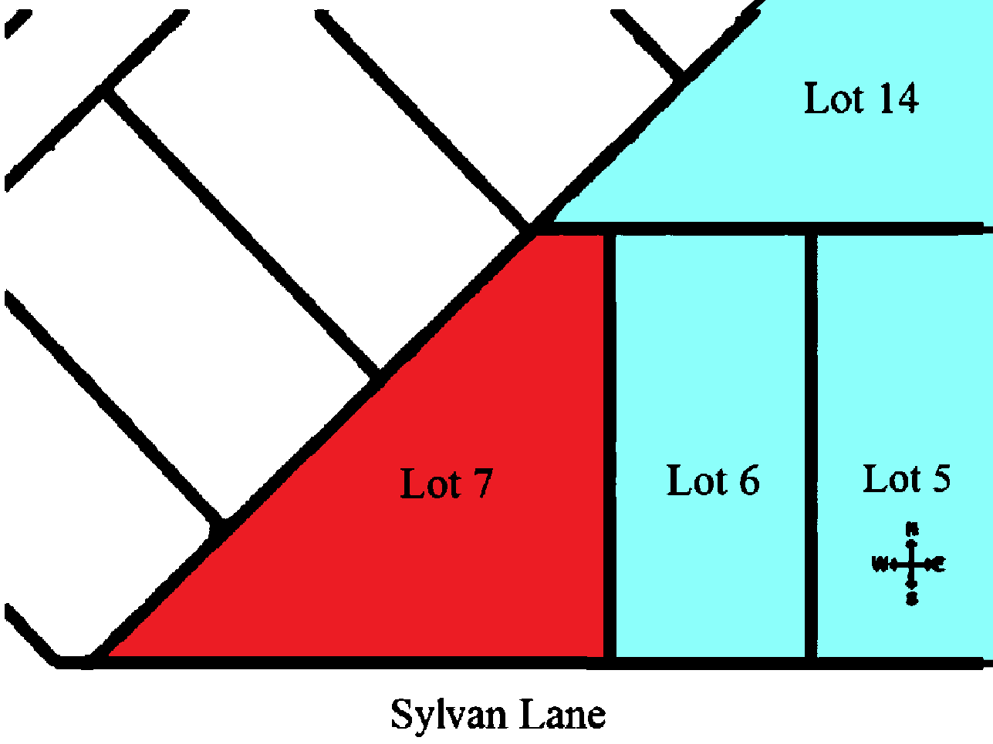
Case #2b:
Ramos v. Potkowski, 322 Or. App. 686 (2022)
Facts
  Neighbors owned adjoining lots in Marylhurst Heights Subdivision.
  Plaintiffs in red
  Defendant in light blue

Slide 24
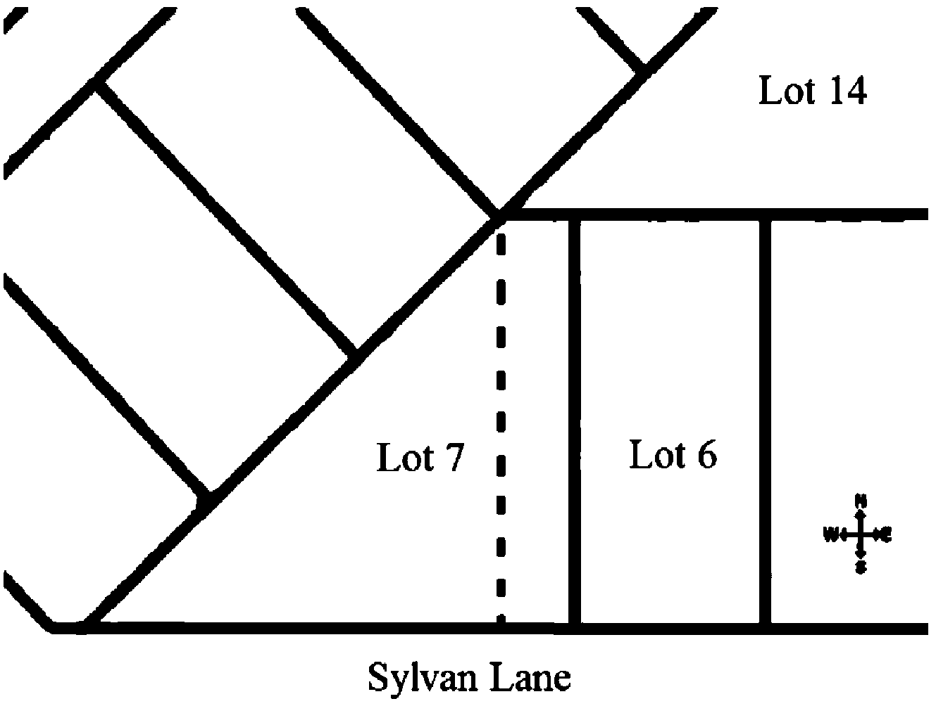
Case #2b:
Ramos v. Potkowski, 322 Or.App. 686 (2022)
Facts
  Plaintiff’s predecessor, Dyer, testified that when he bought in 1993, a neighbor, Kramer, showed him the East boundary of his property as follows:
  The dashed line.

Slide 25
Case #2b:
Ramos v. Potkowski, 322 Or.App. 686 (2022)
Facts
  Kramer appeared 22 years later in 2015 when defendants’ predecessor, Barnard, wanted to build a shed and chicken coop on his property, Lots 5, 6 and 14, and needed guidance about the boundaries.
  Kramer gestured to two stakes or two points.
  Dyer attended this meeting.

Slide 26
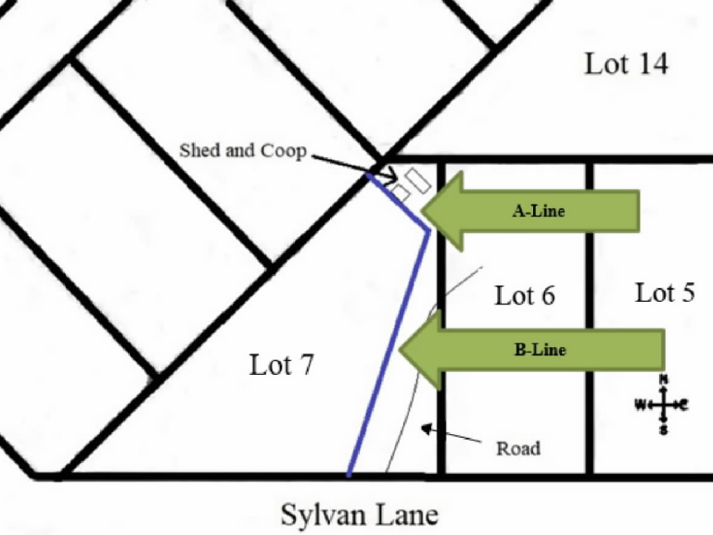
Case #2b:
Ramos v. Potkowski, 322 Or.App. 686 (2022)
Facts
  After that later meeting, Barnard believed his west line to run as follows:

Slide 27
Case #2b:
Ramos v. Potkowski, 322 Or.App. 686 (2022)
Facts
  Plaintiffs learned that Barnards’ improvements (shop, road, chicken coop and shed – now owned by Defendants) encroached over their lot line when they sought to build an ADU on their property.
  Plaintiffs filed suit for trespass and ejectment of the coop, shed, etc.
  Defendants opposed on the theory that a ‘boundary by agreement’ had been reached by the predecessor owners (Dyer and Barnard) under Kramer’s guidance

Slide 28
Case #2b:
Ramos v. Potkowski, 322 Or.App. 686 (2022)
Law
  Elements of boundary by agreement (common law)
    1. there must have been an initial dispute and mutual uncertainty about the true location of the boundary,
    2. there must have been mutual resolution of the uncertainty or dispute by an express or implied agreement to permanently recognize a particular line as the boundary, and
    3. there must be evidence of the agreement by subsequent activities, e.g., recording a written agreement or occupying the property up to the new boundary.

Slide 29
Case #2b:
Ramos v. Potkowski, 322 Or.App. 686 (2022)
Holding
  Here, again, as in case 2a, the parties’ mistaken beliefs about the location of the boundary line did not demonstrate genuine uncertainty as to the ‘true’ location of the line.
  Additionally, they conveyed out using subdivision lot legal descriptions. Their conduct was inconsistent with their understanding and adopting of the alternative boundary lines.

Slide 30
Case #2b:
Ramos v. Potkowski, 322 Or.App. 686 (2022)
Discussion
  We are picky about encroachments over boundary lines.
    Caution if the lines of occupation do not match the boundary lines of record.
    Seeing more infill in Portland.
  Sellers (predecessors to the parties to suit) failed to disclose any boundary issues:
    D. Are there any encroachments, boundary agreements, boundary disputes or recent boundary changes?
      [ ]Yes [ ]No [ ]Unknown
  Recovered monuments (in this case by Kramer) might be offline

Slide 31
Case #2b:
Ramos v. Potkowski, 322 Or.App. 686 (2022)
Discussion
  KRAMER!

Slide 32
Case #3:
Myers v. Owners of Record of that certain real property described as Lot 1, Tract C, Replat of Tract C Deer Park I, Deschutes County.
Facts and posture
  Plaintiff owned property in Sunriver subject to servitudes restricting portions for use as athletic fields (with parking) and open space.
  Plaintiff wanted to open licensed residential care facility on lot.
  Plaintiff sued Sunriver Resort etc. to have restrictions removed under ORS 93.270.

Slide 33
Case #3:
Myers v. Owners of Record of that certain real property described as Lot 1, Tract C, Replat of Tract C Deek Park I, Deschutes County.
Applicable law
  ORS 93.270 allows removal of a covenant restricting use of real property:
    “By any home or facility that is licensed under ORS 443.400 to 443.455 or 443.705 to 443.825 to provide residential care alone or in conjunction with treatment or training or a combination thereof.”
    ORS 93.270(1)(B)(2).
  What is a “residential care facility”
    “Residential care facility” means a facility that provides residential care in one or more buildings on contiguous properties:
    (a)For six or more socially dependent individuals or individuals with physical disabilities or (b) [fewer individuals if needed]

Slide 34
Case #3:
Myers v. Owners of Record of that certain real property described as Lot 1, Tract C, Replat of Tract C Deek Park I, Deschutes County.
Trial court
  Granted plaintiff relief and removed the athletic field covenants / open space covenant
Appellate court
  Not so fast.
  Does a provision in a deed that uniformly limits all or nearly all development of the property violate ORS 93.270(1)(b)(B)?

Slide 35
Case #3:
Myers v. Owners of Record of that certain real property described as Lot 1, Tract C, Replat of Tract C Deek Park I, Deschutes County.
Appellate court holding
  No. ORS 93.270(1)(b)(B) only prohibits provisions that impose restrictions about or concerning use by licensed residential facilities.
  Prohibits restrictions that:
    (1) expressly limit use of the property by a licensed residential facility; and
    (2) have the effect of preventing use of the property by a licensed residential facility, but not other residential uses.
  The statute does not prohibit general property restrictions, like the ones at issue or a conservation easement.

Slide 36
Case #3:
Myers v. Owners of Record of that certain real property described as Lot 1, Tract C, Replat of Tract C Deek Park I, Deschutes County.
Discussion
  ORS 93.270(1)(b)(B) only prohibits property restrictions that specifically prevent use for a licensed residential facility but not other residential uses.
    General restrictions that incidentally make it impossible to use a licensed residential facility (but also other uses) on the property do not violate the statute.
  Relevance: ORS 93.270(1)(a) also lists protected categories which may not be the subject of discriminatory covenants in Oregon, and was just overhauled to provide an easier way to remove them.

Slide 37
Part II:
Legislative Update

Slide 38
House Bill 3294: Redaction of Discriminatory Covenants
Background: ORS 93.270(1)(a)
  A person conveying or contracting to convey fee title to real property, or recording a declaration under ORS 94.580 may not include in an instrument for that purpose a provision:
    (a) Restricting the use of the real property by any person or group of persons by reason of race, color, religion, sex, sexual orientation, gender identity, national origin or disability.
  Additionally any such covenants are void ab initio.
Two mechanisms to enforce removal:
  ORS 93.274 (protected categories discrimination) and ORS 93.272 (all others, such as residential care facility / child care facility restrictions)
HB 3294 amends ORS 93.274

Slide 39
House Bill 3294: Redaction of Discriminatory Covenants
Prior law (2018 Oregon Laws, Ch. 35, sec. 1)
  Petitioner had to mail notice of the proceeding to remove the covenant to all affected owners.
  Affected owners could request hearing on validity.
  Sole issue to decide was whether covenant violated ORS 93.270(1)(a).
  The court entered a judgment removing the covenant from the record.

Slide 40
House Bill 3294: Redaction of Discriminatory Covenants
Prior law (2018 Oregon Laws, Ch. 35, sec. 1)
  Practical problems:
  Judgment declaring covenant void merely republishes offensive covenant.
  Priority date of original covenants’ still valid provisions preserved?
  Integrity of records. What if valid covenants get lost in the redaction process?

Slide 41
House Bill 3294: Redaction of Discriminatory Covenants
2023 Legislative Session background
  Lake Oswego legislator wanted law revised.
    Initial suggestion was to made county recorders responsible to review and redact discriminatory covenants.
    Other proposals (such as in California) have required title offices to perform this work.
  OLTA worked with County Counsel (recorders) to produce a workable solution.

Slide 42
House Bill 3294: Redaction of Discriminatory Covenants
Updated law:
  Now an in rem action against all affected property
    Example: just one lot owner in a subdivision may remove covenant from all lots in subdivision
    Affected lot owners are not notified
  Petition sets out discriminatory covenant, but if the court agrees, the covenant is not republished in the county records. It says in the court case.
  (next slide)

Slide 43
House Bill 3294: Redaction of Discriminatory Covenants
If the court finds that any provisions of the recorded instrument or declaration are void by reason of ORS 93.270 (1)(a), the court shall enter an order:
  (A) Finding that the referenced original written instrument or declaration contains discriminatory provisions that are void and unenforceable under ORS 93.270 (1)(a);
  (B) Identifying each document by recording number and date of recordation; and
  (C) Striking the void provisions from the public records and eliminating the void provisions from the title to the property described in the petition.
The order must include a certified copy of each document upon which the court has physically redacted the void provisions.
The order must provide that the effective date of the document redacted by the court is the same as the effective date of the original document.

Slide 44
House Bill 3294: Redaction of Discriminatory Covenants
(4) A county clerk who receives a certified copy of an order and redacted document described in this section with the fees required under ORS 205.320 shall:
  (a) Record the order and the certified copy of the document upon which the court has physically redacted the void provisions;
  (b) Update the index of each original document referenced in the order with the recording number of the modified document; and
  (c) Maintain the original document or an image thereof separately from electronic public access and preserve the original document or image for historical or archival purposes.

Slide 45
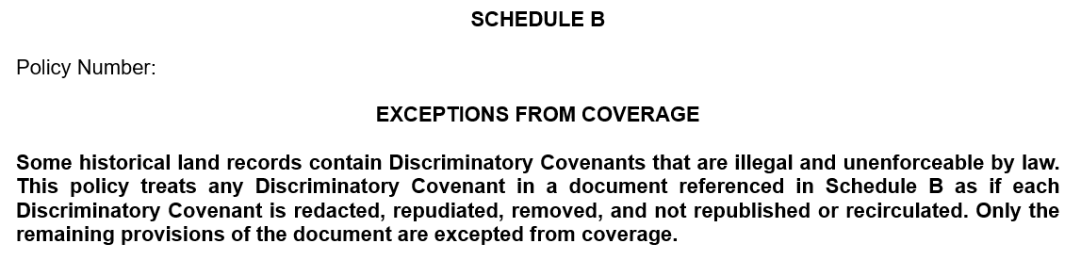
House Bill 3294: Redaction of Discriminatory Covenants
Effective date: Jan. 1, 2024
  Any petitions filed under the prior (2018) law may be amended to conform with this 2023 revision prior to Jan. 2, 2026
  Model petition forms will be produced for use by the public.

Slide 46
House Bill 2029: Increases minimum font size for recorded documents.
Increases minimum font size from 8 point to 10 point for recorded documents.
Applies to docs recorded after effective date.
  As before, does not apply to out of state notarial certs or certified copies of public records.
  We believe footnotes and endnotes will be exempted from minimum size requirements. Source: personal communication with clerks.
Effective date: January 1, 2024.
Notes:
https://olis.oregonlegislature.gov/liz/2023R1/Measures/Overview/HB2029

Slide 47
House Bill 2029: Increases minimum font size for recorded documents.
Testimony: Mr. Oregon supports the Bill, but bemoans that the increase isn’t to even larger minimum font sizes.
Practice tip: Scaling.
High-definition screens make text appear smaller.
“Display Settings”:
Notes:
https://olis.oregonlegislature.gov/liz/2023R1/Measures/Overview/HB2029

Slide 48
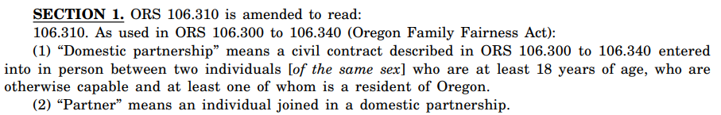
House Bill 2032: Expands eligibility for registered domestic partnerships
Prior Law
  Oregon Family Fairness Act
    Effective Feb. 4, 2008, before same-sex marriage was available in Oregon (2014).
    Authorized Registered Domestic Partnerships (RDPs) only for same-sex couples.
  Registered: not merely informal or implicit
New Law
  RDPs are now available regardless of sex of partners:
Notes:
https://olis.oregonlegislature.gov/liz/2023R1/Measures/Overview/HB2032

Slide 49
House Bill 2032: Expands eligibility for registered domestic partnerships
May RDPs hold as tenants by the entireties / are they presumed to so hold?
  OFFA extends all of the “privileges, rights and immunities” of married spouses to RDPs. ORS 106.340(1)
  However, ORS 93.180(3) presumes that ‘spouses married to each other’ take as TBEs, absent other vesting words such as tenants in common.
    Does not apply presumption to RDPs.
    RDPs are not spouses married to each other (or to any other person). See ORS 106.315(1)(a).
  There is a difference of opinion on whether a TBE is presumed when RDPs take title with no concurrent estate listed.
    Best practice is to be explicit and have them specify their concurrent estate when taking title.
Effective Date: January 1, 2024
Notes:
https://olis.oregonlegislature.gov/liz/2023R1/Measures/Overview/HB2032

Slide 50
House Bill 2032: Expands eligibility for registered domestic partnerships
RDPs are created by state law; but not recognized under federal law
  Testimony of PERS. Neutral.
  Retirement plans under federal law.
Mr. Oregon ‘gladly concurs’ in the bill.
Notes:
https://olis.oregonlegislature.gov/liz/2023R1/Measures/Overview/HB2032

Slide 51

House Bill 2032: Expands eligibility for registered domestic partnerships
Title and escrow.
New endorsement, OTIRO 110, Domestic Partner.
  For use with 2021 ALTA Owner’s policies.
  Reference to ‘spouse’ in owner’s policy jacket;
  “Insured” includes:
Notes:
https://olis.oregonlegislature.gov/liz/2023R1/Measures/Overview/HB2032

Slide 52
House Bill 2033: Clarifies collection of unpaid taxes following conveyance to exempt entity.
Background
  When a taxable owner conveys real estate to a grantee exempt from taxation (state or local government, feds) the assessor must certify ad valorem taxes have been paid in full.
  Certificate is recorded with deed. (Escrow duty.)
  However, in practice, deeds to exempt holders are not always recorded with the certificates since assessors don’t always quickly provide the certificate.
Notes:
https://olis.oregonlegislature.gov/liz/2023R1/Measures/Overview/HB2033

Slide 53
House Bill 2033: Clarifies collection of unpaid taxes following conveyance to exempt entity.
Background
  List of exempt grantees: ORS 307.040 to 307.090.
  The grantor had the obligation to pay all taxes and remained personally liable. Subsection (6).
Effect of new law:
  Re-iterates that if the deed happens to be recorded without the assessor’s certification, the taxes remain the unsecured personal obligation of grantor.
Effective Date: September 24, 2023.
Notes:
https://olis.oregonlegislature.gov/liz/2023R1/Measures/Overview/HB2033

Slide 54
House Bill 2033: Clarifies collection of unpaid taxes following conveyance to exempt entity.
Discussion
  Prior law already provided the unpaid taxes would be the grantor’s personal liability.
    This revision just contemplates the effect of recording the deed without the required certificate.
  The lien for taxes does not attach to property while in exempt ownership; could it reattach if sold back into non-exempt ownership?
  Escrow is an “authorized agent” required to submit the certificate from the assessor with the deed. Disclose risks of proceeding to seller if recording without one.
Effective Date: January 1, 2024
Notes:
https://olis.oregonlegislature.gov/liz/2023R1/Measures/Overview/HB2033

Slide 55
Senate Bill 308: Modifies small estate affidavit statute.
Small estates are rebranded as ‘simple estates’
Intestate estates:
  Eligibility threshold unchanged.
  Fair market value no more than $200,000 real property, $75,000 personal property.
  Determined under ORS 114.510(2).
Notes:
https://olis.oregonlegislature.gov/liz/2023R1/Measures/Overview/SB308

Slide 56
Senate Bill 308: Modifies small estate affidavit statute.
Testate estate updates:
  Property devised to the trustee of a trust of which decedent is settlor is excluded from threshold amounts. (Pour-over will)
    Devise, defined: to dispose of property by will.
    N.B., trust must have been established prior to settlor’s death.
  Common scenario:
    Estate planning client signs a pour-over will and trust agreement.
    But forgets to deed property to trust during lifetime.
  The will may not contain specific devises over the threshold amounts, or general devise of valuable property.
Notes:
https://olis.oregonlegislature.gov/liz/2023R1/Measures/Overview/SB308

Slide 57
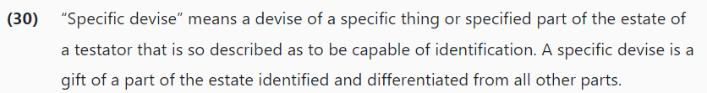
Senate Bill 308: Modifies small estate affidavit statute.
Testate estate filing thresholds:
  $200,000 of specifically devised real property (FMV).
  $75,000 of specifically devised personal property (FMV).
  Example: “I devise my 2-carat diamond ring to my niece, Sarah.”
    Note: “devise” is not limited to real property under Oregon Probate Code.
  What about general devise/bequests?
Notes:
https://olis.oregonlegislature.gov/liz/2023R1/Measures/Overview/SB308

Slide 58
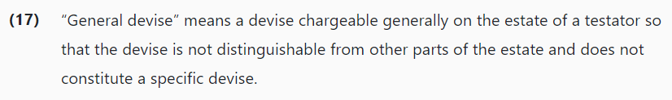
Senate Bill 308: Modifies small estate affidavit statute.
Testate estate filing thresholds:
  A general devise disqualifies the estate for the SEA procedure.
    (Unless the property has zero fair market value.)
    Example: “I bequeath Sarah $10,000.”
      This gift may be satisfied by any funds held by the estate and does not require the transfer of specific property, such as a car, house, or boat.
  We may want to review wills and inventories to confirm that the will does not contain a general devise of property with a non-zero value.
Notes:
https://olis.oregonlegislature.gov/liz/2023R1/Measures/Overview/SB308

Slide 59
Senate Bill 308: Modifies small estate affidavit statute.
Additional requirement.
  The affiant must also file a copy of the trust agreement or a certificate of trust if using the new threshold exemption. SB308 Section 3a.(4).
Effective Date: January 1, 2024
  The amendments apply to small simple estate affidavits filed on or after the effective date.
    So even if decedent died before effective date, the estate is potentially still eligible for new treatment.
  Valuation dates not changed. ORS 114.510(2).
    Date of death, or if SEA filed more than one year after death, a date that is within 45 days of filing.
Notes:
https://olis.oregonlegislature.gov/liz/2023R1/Measures/Overview/SB308

Slide 60
Senate Bill 619: Consumer data privacy
Legislative summary:
  Permits consumers to obtain from controller that processes consumer personal data confirmation as to whether controller is processing consumer's personal data and categories of personal data controller is processing, list of specific third parties to which controller has disclosed consumer's personal data or any personal data and copy of all of consumer's personal data that controller has processed or is processing. Permits consumer to require controller to correct inaccuracies in personal data about consumer, require controller to delete personal data about consumer or opt out from controller's processing of consumer's personal data under certain circumstances. Requires controller to provide to consumers reasonably accessible, clear and meaningful privacy notice that lists categories of personal data controller processes, describes controller's purpose for processing personal data, describes how consumer may exercise consumer's rights with respect to personal data, lists categories of personal data that controller shares with third parties, lists all categories of third parties with which controller shares personal data and provides other information. Specifies duties of, and prohibits specified actions of, controller and of processor that acts at controller's direction. Permits Attorney General to investigate violations of Act and to bring action to seek civil penalty of not more than $7,500 for each violation. Permits consumer or class of consumers to bring action after specified date for ascertainable loss of money or property resulting from violation of Act.].
Notes:
https://olis.oregonlegislature.gov/liz/2023R1/Measures/Overview/SB308

Slide 61
Senate Bill 619: Consumer data privacy
OLTA involvement
  Affiliates (who are not financial institutions) or independent escrow companies may be subject to ambit of SB 619 without the benefit of an exemption
  We may need to revisit the law to tweak exemptions in a future session.
    Trying to harmonize state-wide with GLBA so there are not separate consumer data privacy regimens in each state.
    Bill was already contentious and a high priority of the Oregon AG.
Notes:
https://olis.oregonlegislature.gov/liz/2023R1/Measures/Overview/SB308

Slide 62
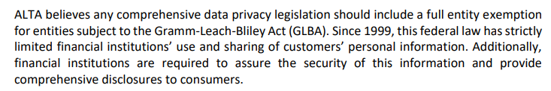
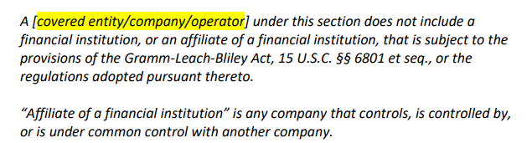
Senate Bill 619: Consumer data privacy
OLTA involvement
  ALTA recommends a “entity level” exemption as follows:
Notes:
https://olis.oregonlegislature.gov/liz/2023R1/Measures/Overview/SB308

Slide 63
BONUS CASE if we have time:
KKMH Properties LLC v. Shire, 326 Or.App. 1 (2023)
Tenant of residential unit kept 226 uncaged guinea pigs on premise and allowed water leaks.
Landlord terminated tenancy for cause, but did provide tenant opportunity to ‘cure’ the breach
Held: as a matter of law, the damage could not be cured in 14 days, and no cure opportunity needed to be given.

Slide 64
Other cases of interest:
Farnsworth v. Meadowland Ranches, Inc. 321 Or.App. 814 (2022)
  Developer of unrecorded subdivision failed to expressly create easement benefitting successors, but reserved one for himself. Held: no easement created in favor of successors.
Adelsperger v. Elkside Development, LLC, 321 Or. App. 809 (2022)
  Purchaser of membership campground predictably tried to raise camping rates and dishonor prior owner’s concessions to campers. On appeal, Purchaser failed to preserve issue of whether campground contracts ran with the land. Commercial purchasers should beware of contracts granting rights to the land they are purchasing.
u Petix v. Gillingham, 325 Or. App. 157 (2023)
  Following sheriff’s sale, defendant Aries Holdings 1, LLC purchased the foreclosed borrower’s redemption rights (by unrecorded deed) and also the sheriff’s certificate of sale by assignment. Rather than redeem the property, Aries obtained a sheriff’s deed and leased the property back to the foreclosed borrower. Plaintiff Petix was a judgment creditor of the foreclosed borrower before the sale who alleged that because Aries “could have” redeemed, it was inequitable that borrower have continued use of the property (through a lease with option to purchase) now free of plaintiff’s judgment, washed through the foreclosure. Held: Aries was not required to redeem and the circumstances did not amount to a “constructive redemption” in which liens against the borrower would re-attach to the property.

Slide 65
End
Comments?
“Now that Jay Dobson, he was one funny guy.”
“They gave the ‘farm guy’ way too much time to present his material.”
“I miss Cleve, he was truly a scholar.”
“Too much text and reliance on PowerPoint. Alan always had his material down cold and presented it with panache.”

Slide 66
Disclaimer
Nothing in this slideshow constitutes legal advice or statements of Fidelity National Title Group offered for any purpose other than current education of members of Oregon Land Title Association.
Any images are used for the non-commercial educational purposes of OLTA members.

